Slide 1


Slide 2



Slide 3

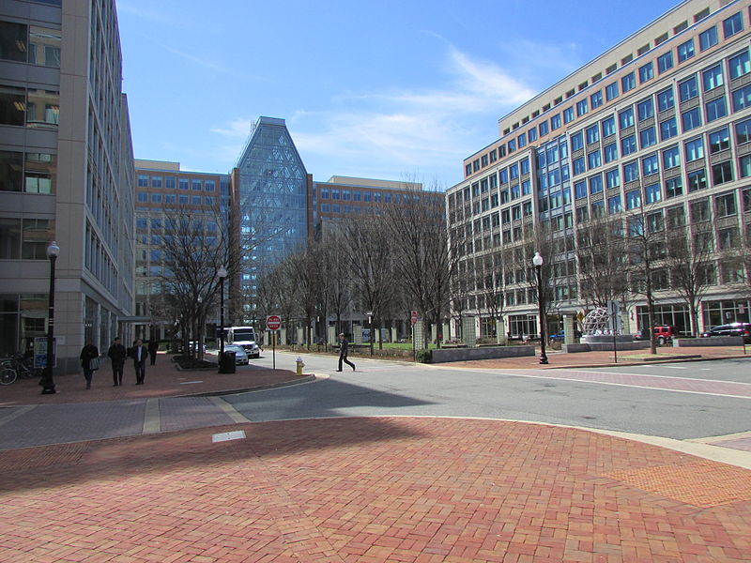
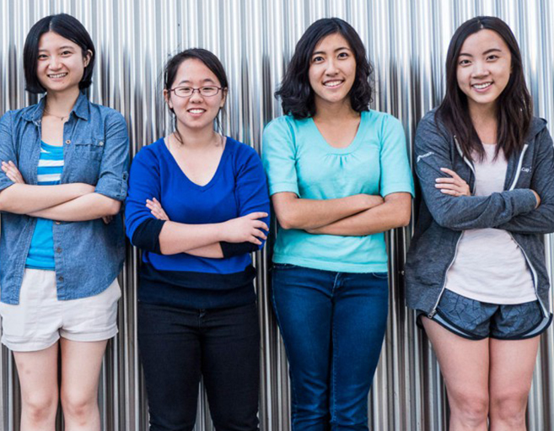
What is a Patent?
A patent is a type of property right granted by the government that lets the inventor stop others from making, using, or selling their invention without the inventor’s permission
The United States Patent and Trademark Office (USPTO) is the government agency responsible for issuing patents and registering trademarks in the United States
Anyone can be an inventor and apply for a patent! Including you!

Slide 4
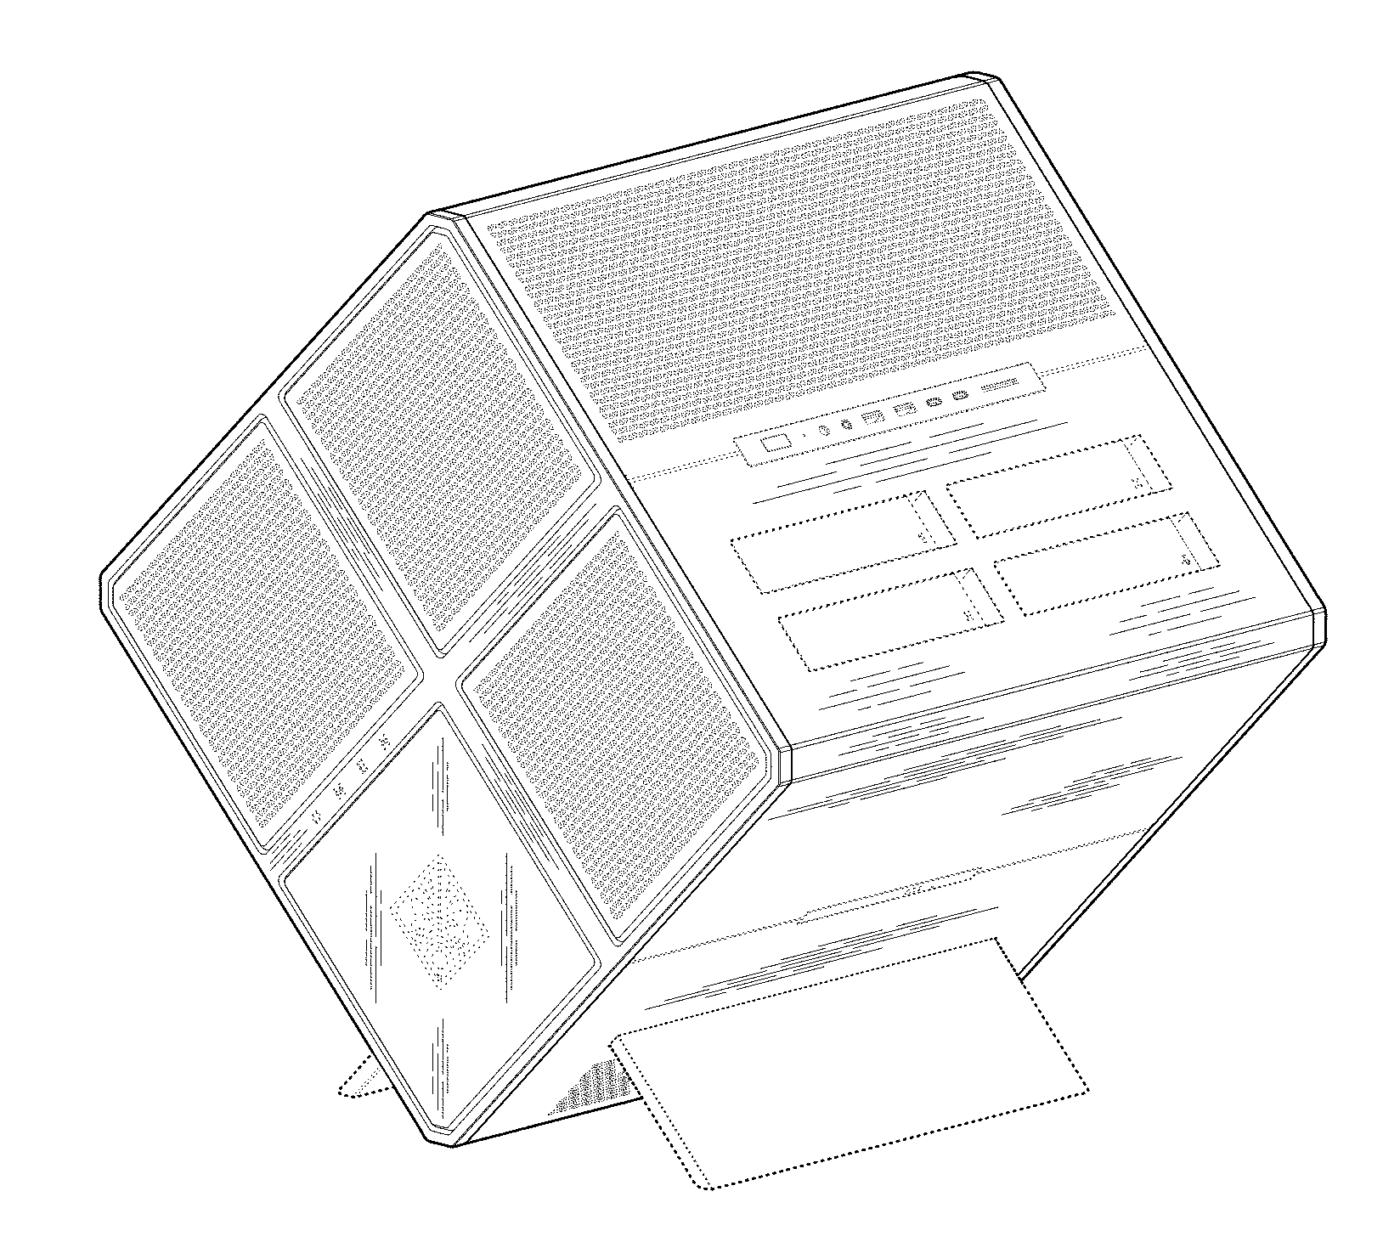
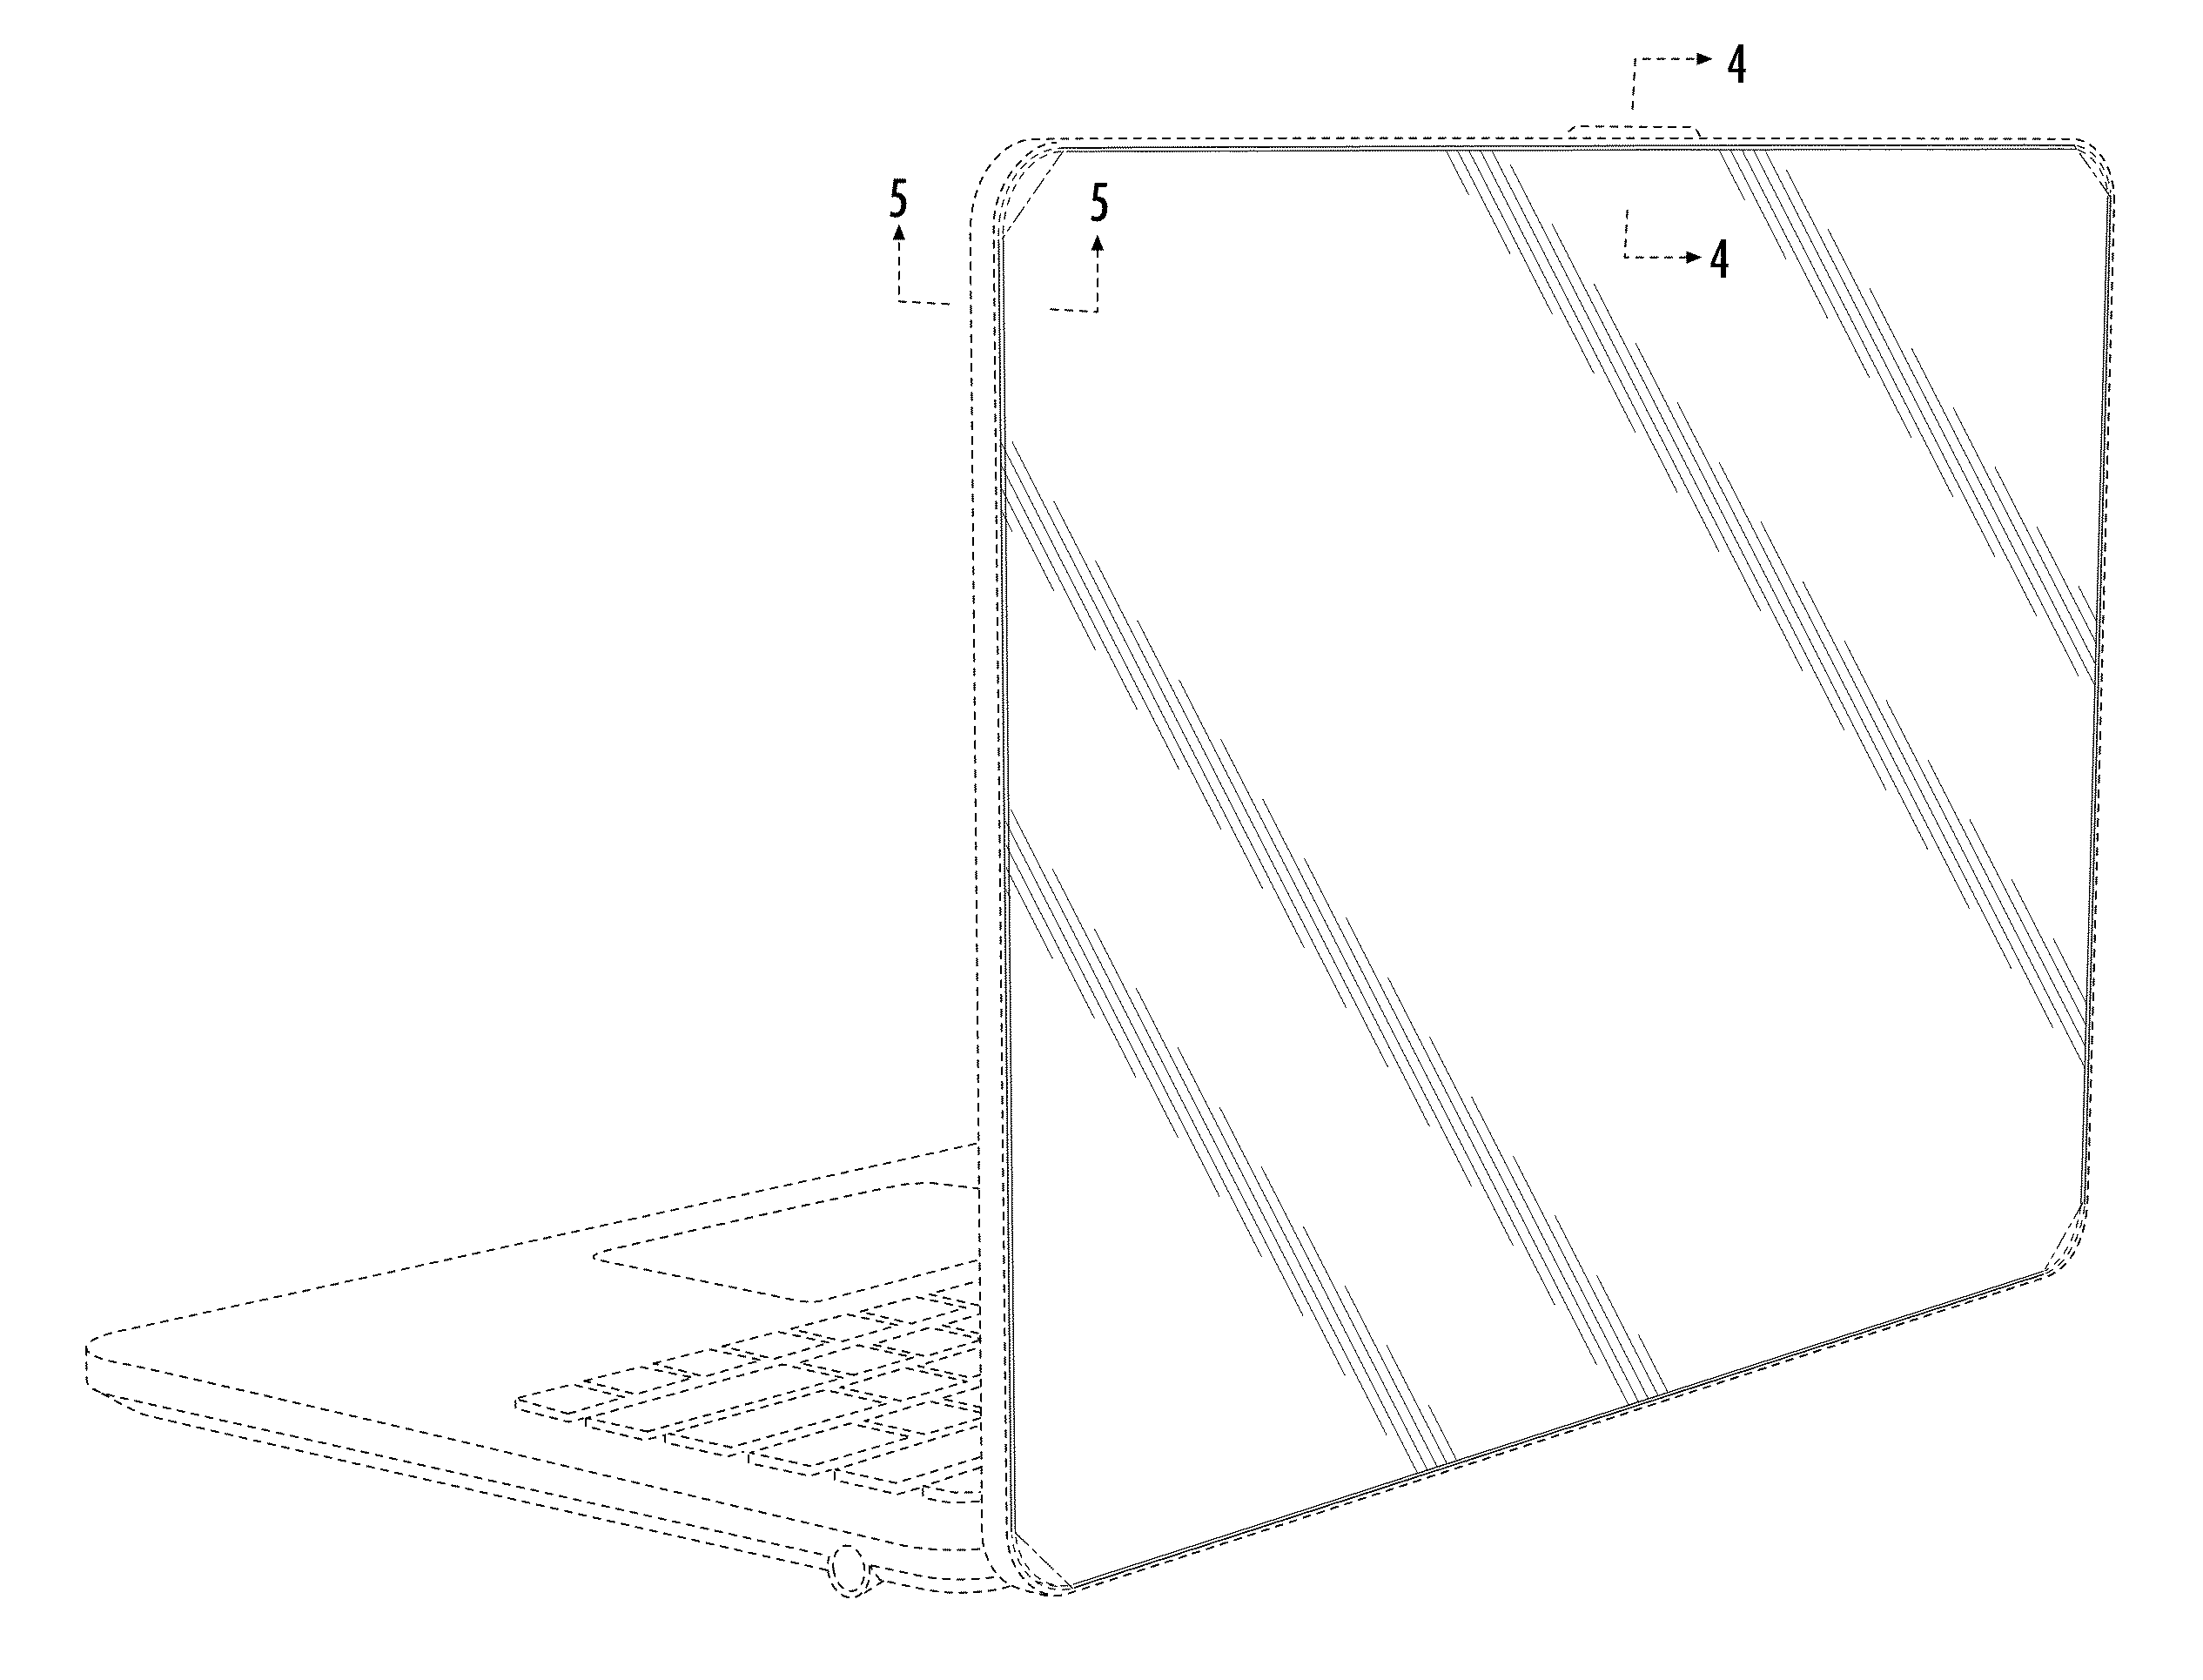
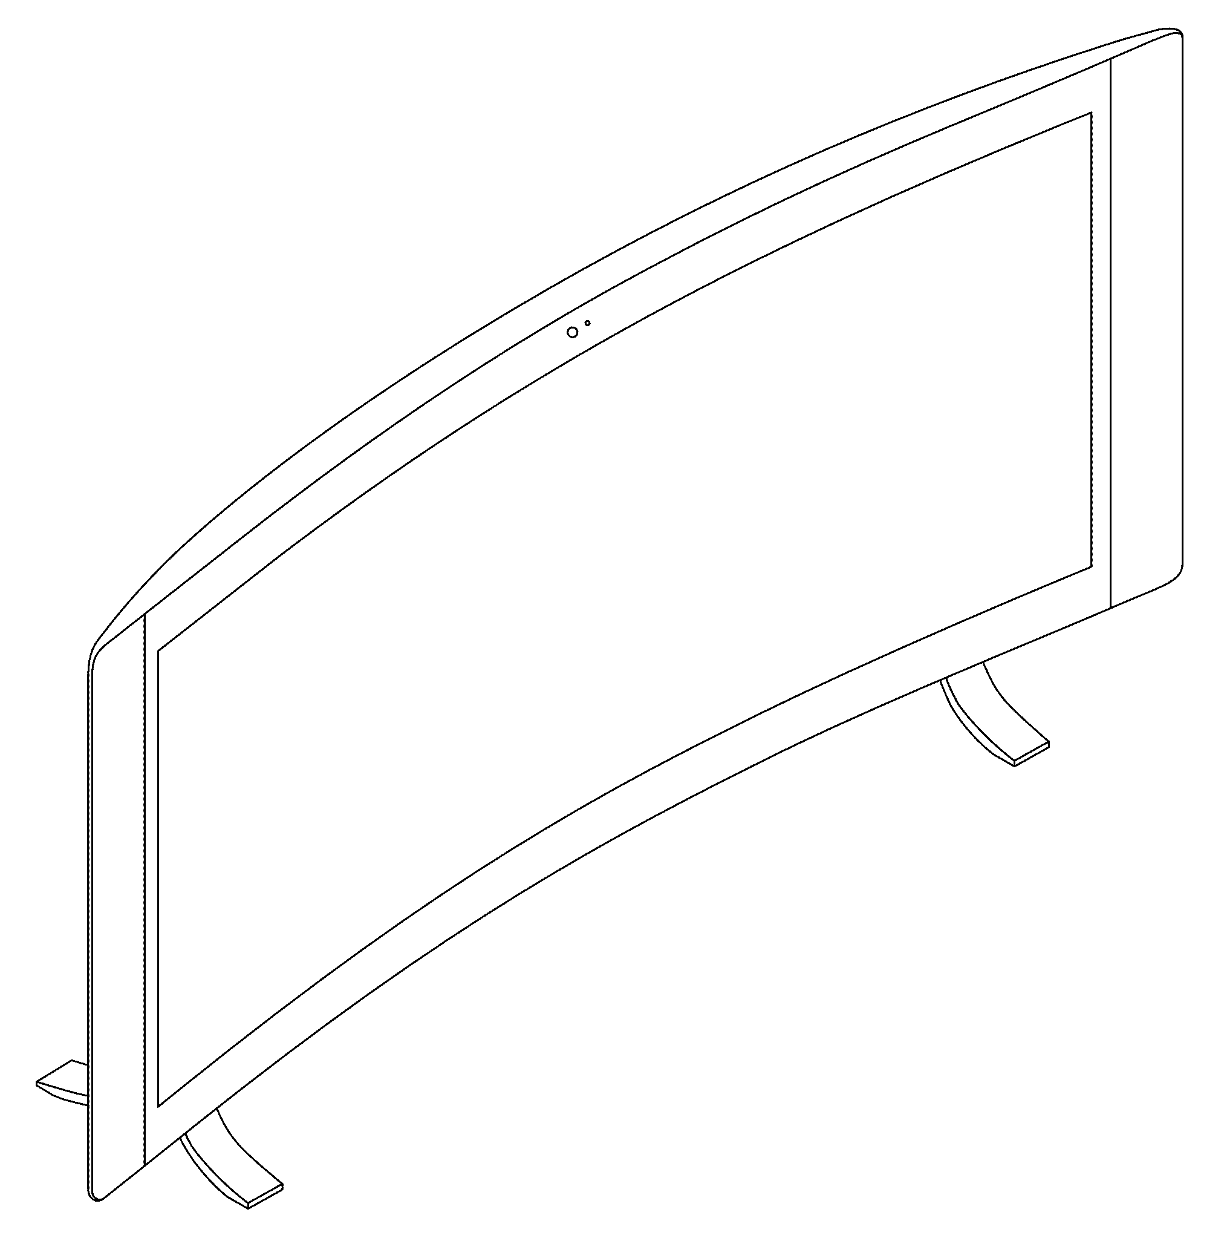
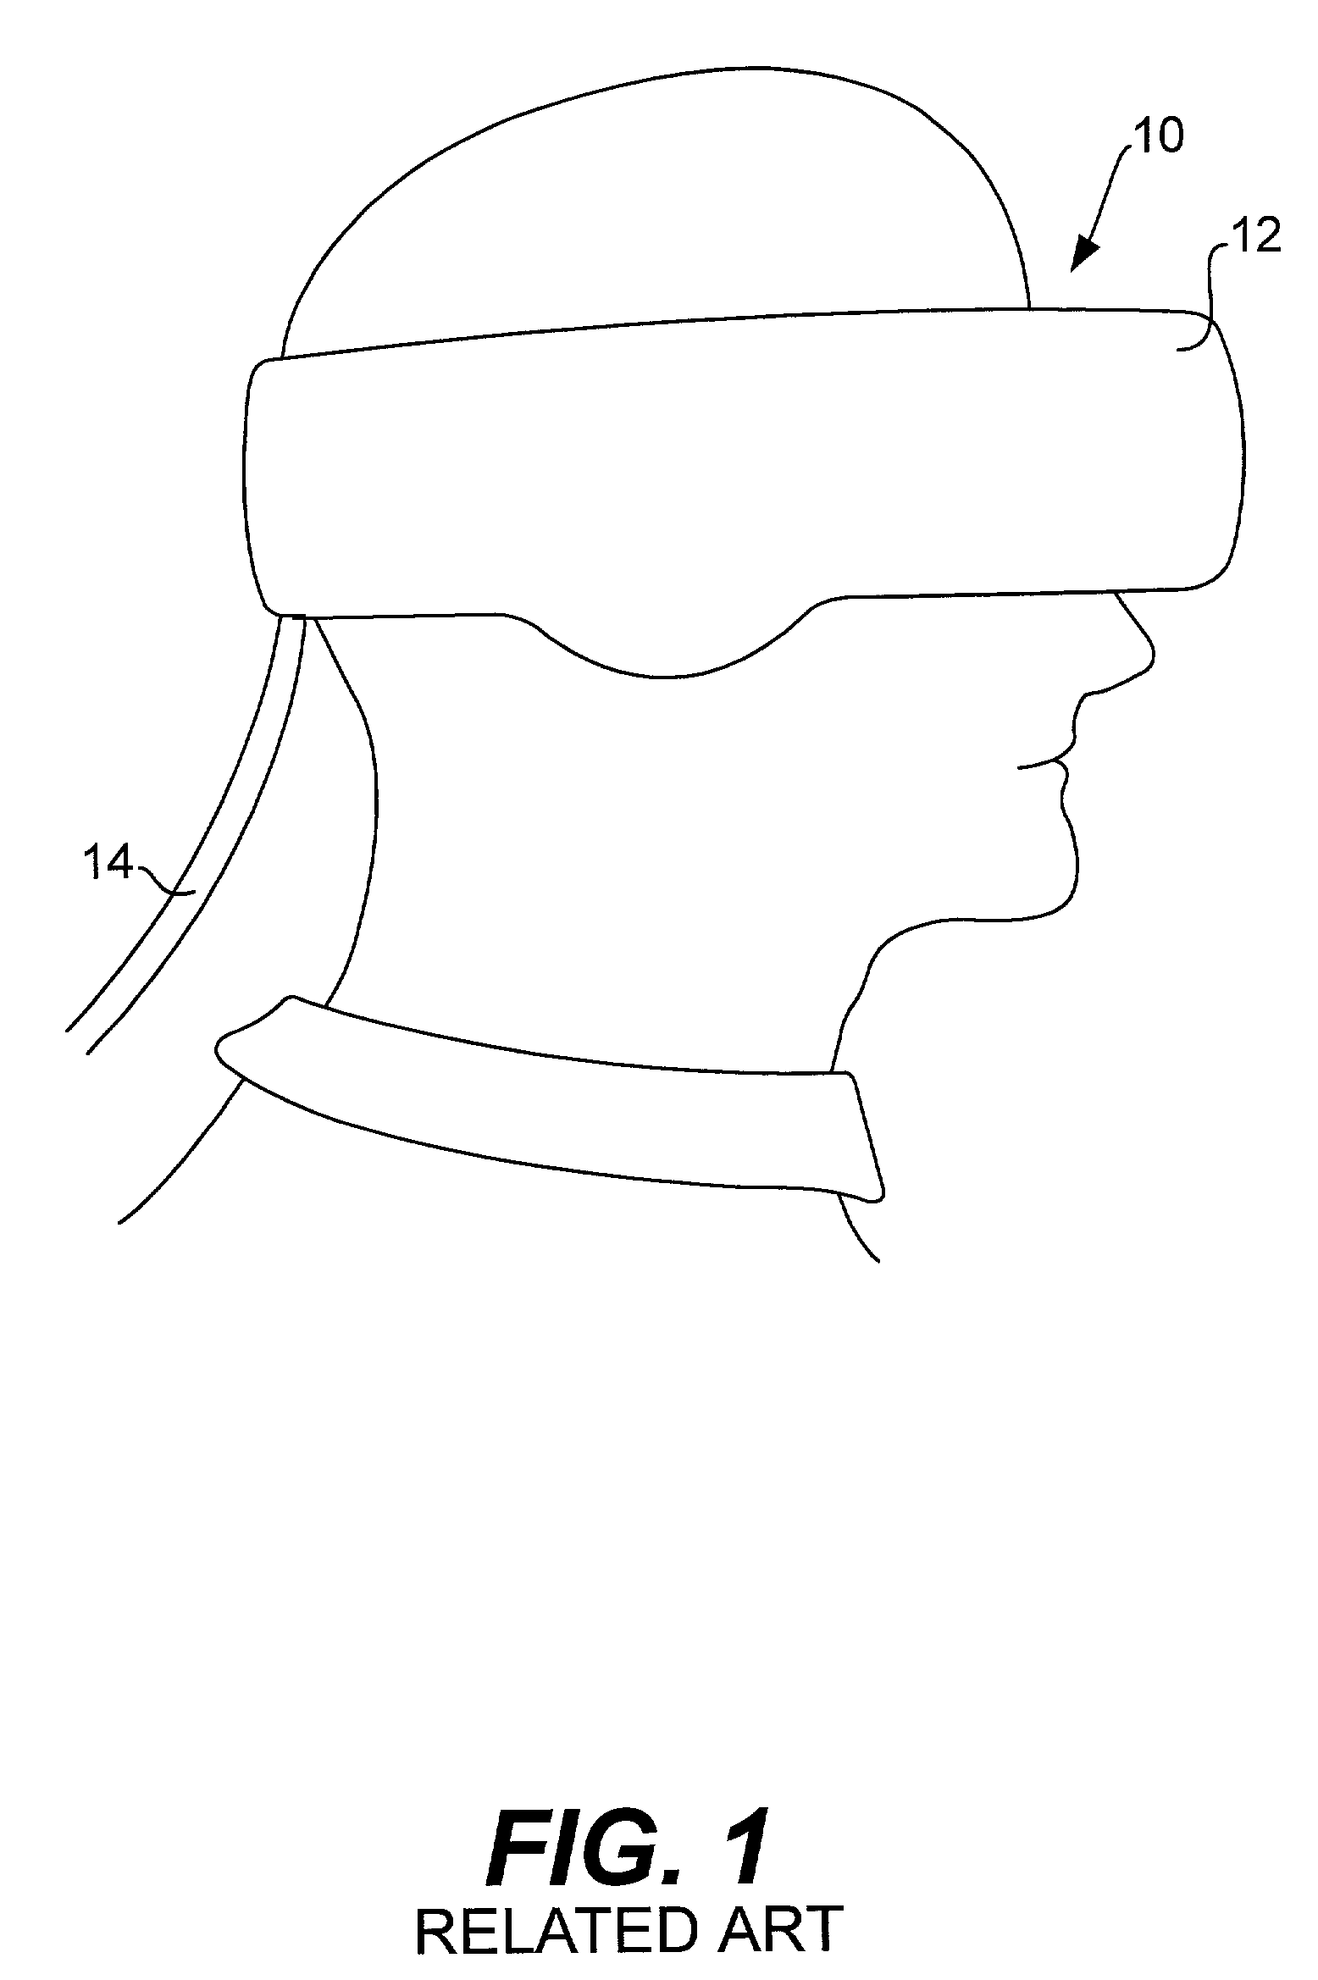
D684152 – back cover made from glass
D797102 – cube desktopD797102 – cube desktop
7081870 - Wearable Display And Method Of
Displaying Images Using A Wearable Display
D786245 – curved screen desktop

Slide 5
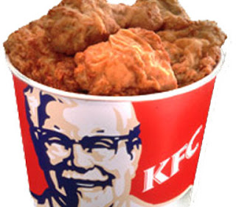

What is a Trade Secret?

Slide 6


What is a Trademark?

Slide 7
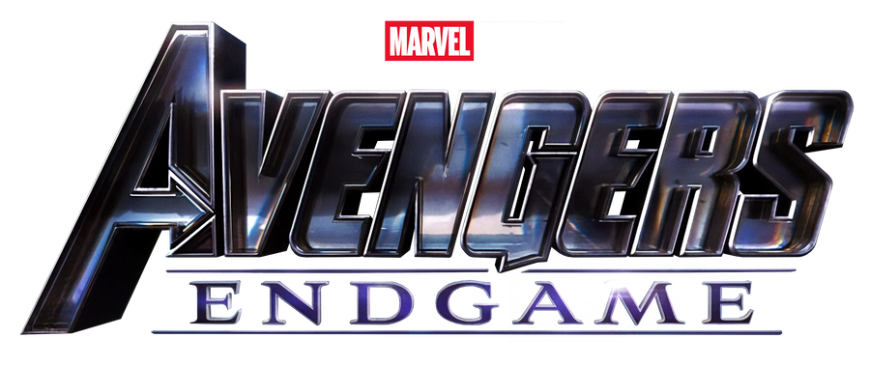
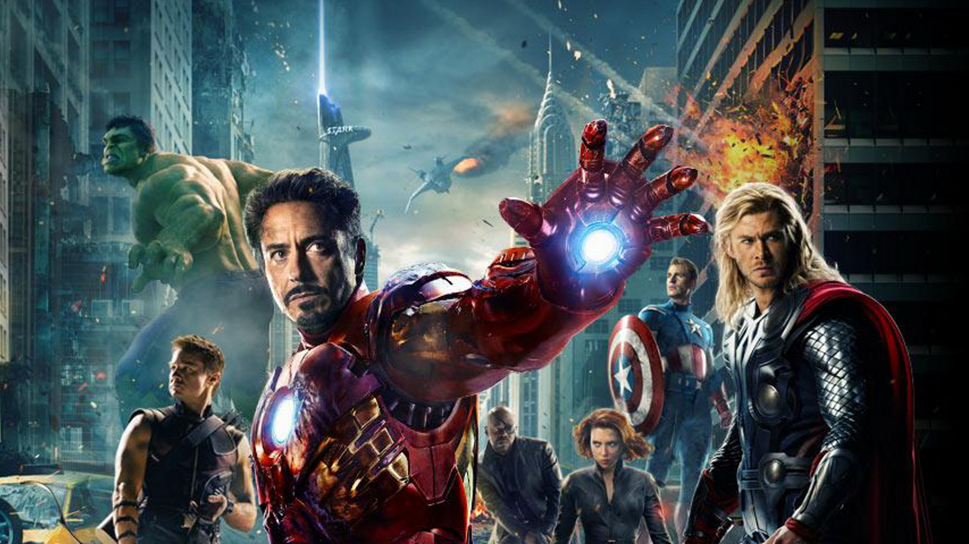
What is Copyright?

Slide 8


