Slide 1
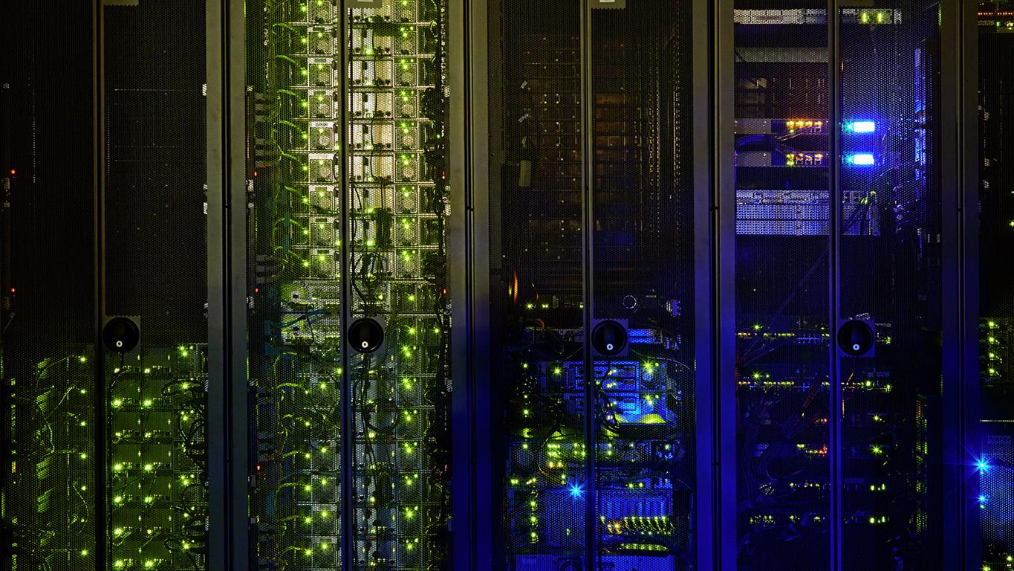
Patent Session
Girl Scout IP Patch
Welcome Girl Scouts!
Caroline Pinkston
Ariana Woods
May 7, 2016

Slide 2

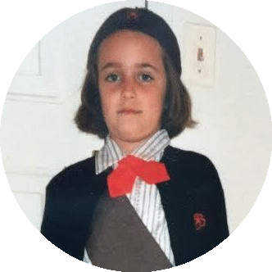
Welcome Girl Scouts!
Caroline
Age 9
Patent Counsel
Hewlett Packard Enterprise
Ariana
Age 7
Senior Patent Counsel
Hewlett Packard Enterprise

Slide 3

Today we will explore . . .
What a patent is
Who can be an inventor
What a patent looks like
How to think like an inventor

Slide 4
What is a patent?

Slide 5
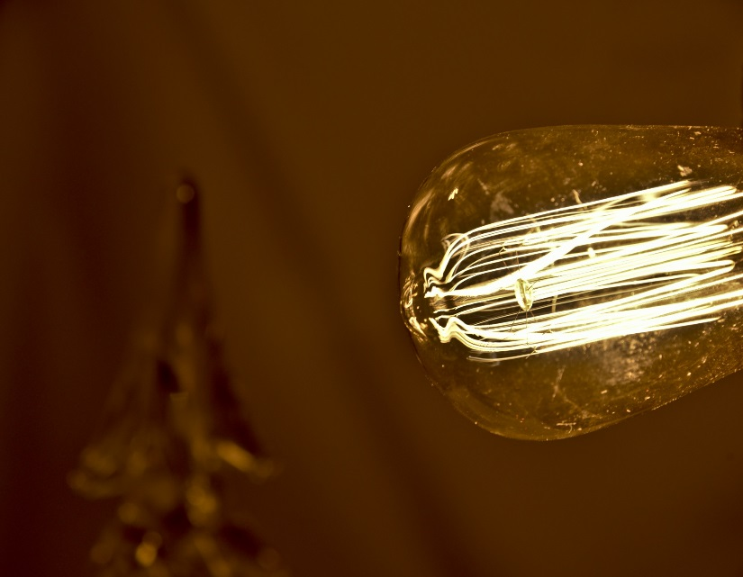
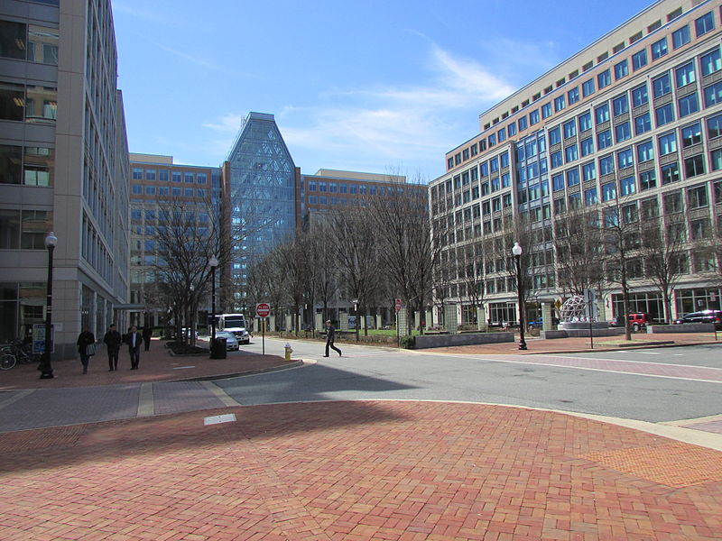
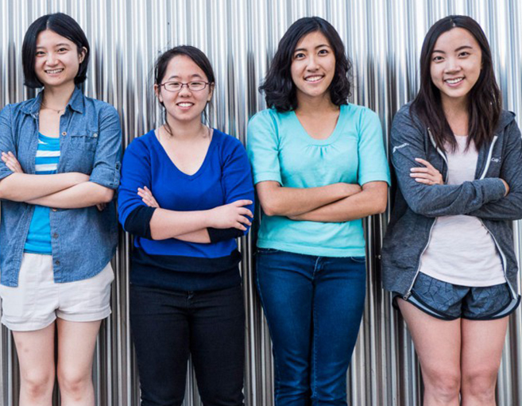
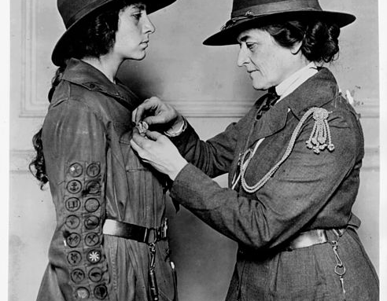
Patent Overview
What?
Where?
Who?
A patent is a type of property right granted by the government that lets the inventor stop others from making, using, or selling their invention without the inventor’s permission
The United States Patent and Trademark Office (USPTO) is the government agency responsible for issuing patents and registering trademarks in the United States
Anyone can be an inventor and apply for a patent! Including you!
Notes:
The light bulb image is in the public domain (http://www.publicdomainpictures.net/view-image.php?image=139825&picture=edison-bulb-and-christmas-tree)
The image of the USPTO is obtained from Wikimedia Commons (https://commons.wikimedia.org/wiki/File:USPTO4000.JPG) and is being used under the Creative Commons Attribution-Share Alike 3.0 Unported license (available at https://creativecommons.org/licenses/by-sa/3.0/deed.en).
The image of Juliette Gordon Low is in the public domain (https://commons.wikimedia.org/wiki/File:Juliettegordonlow-pinning.jpg)

Slide 6
Patents protect different types of inventions
Let’s run through a few examples together

Slide 7
Patents protect different types of inventions
Animal Ear Protectors
Apparatus for Simulating a “High Five”
Apparatus for Harnessing Wind to Drive a Bicycle
Animal Ear Protectors

Slide 8
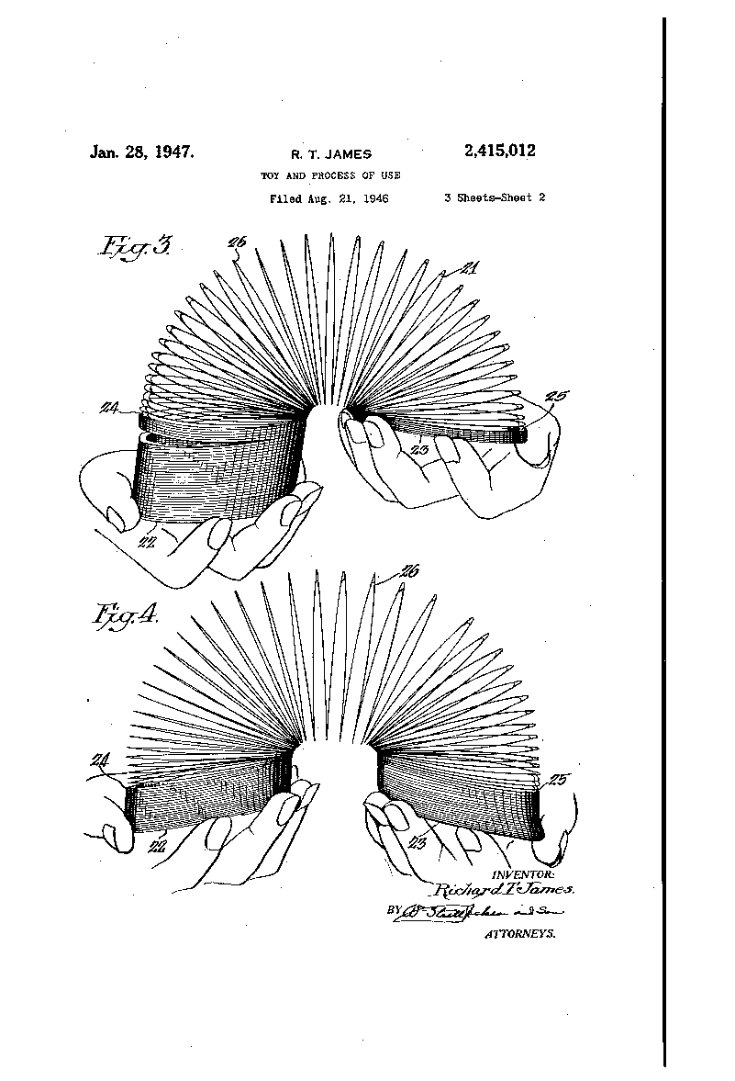
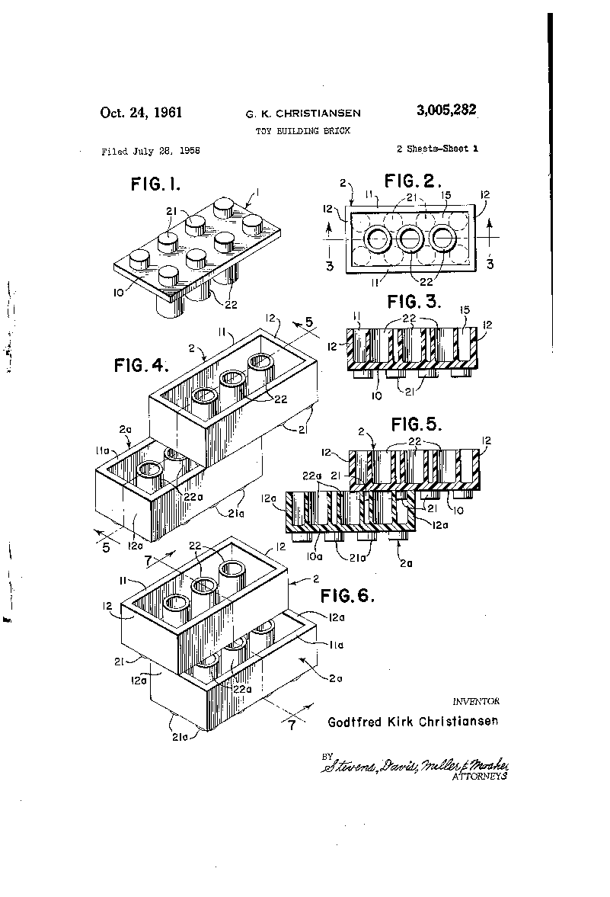
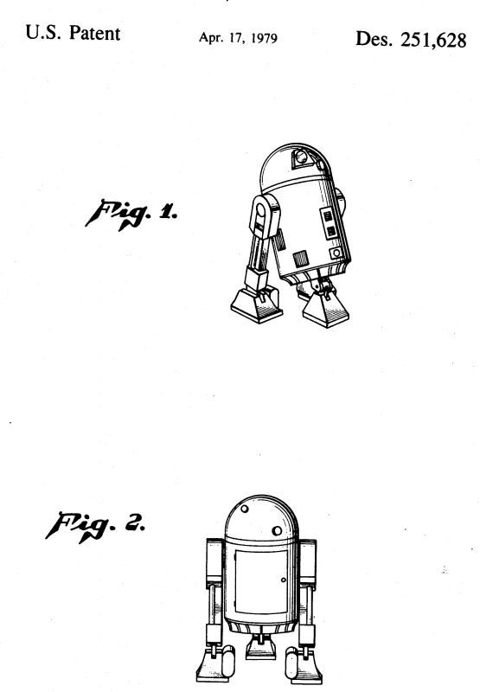
Can You Guess What These Patents Protect?

Slide 9
Who can be an inventor?

Slide 10
Anyone can be an inventor!
Including you!

Slide 11
Juliette Gordon Low, Inventor
Did you know that Girl Scouts founder Juliette Gordon Low was also an inventor?
She invented a garbage can liquid container, made of cheap, non-metallic waterproof paper
US Patent No. 1,124,925

Slide 12
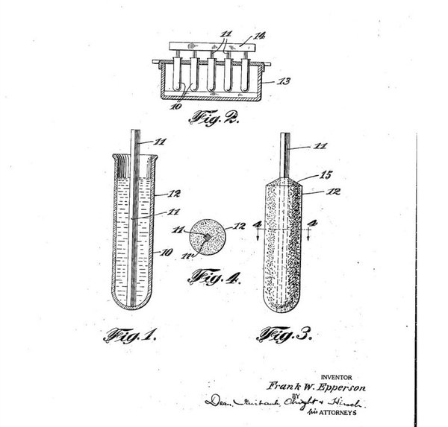
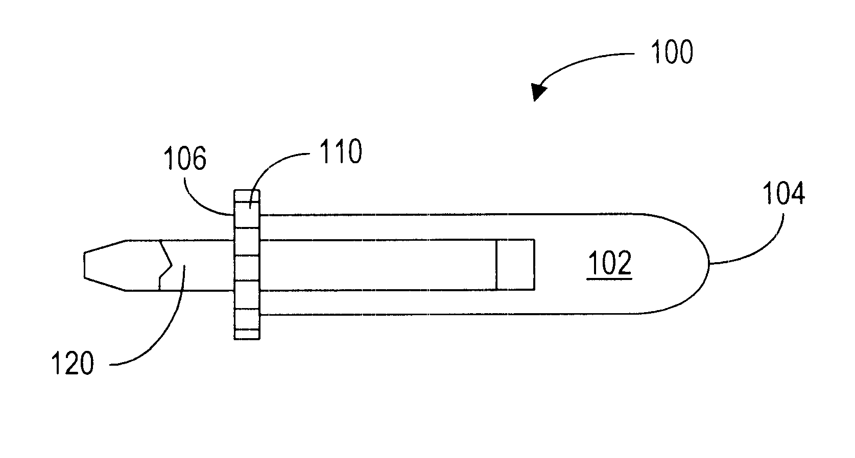
Young Inventors
Luminescent Backing Sheet for Writing in the Dark
-Becky Schroeder age 10
Device for Holding a Writing Instrument
-Cassidy Goldstein age 12
Frozen Confectionary
-Frank Epperson age 11
Notes:
Beck Schroeder (10 yo): Invented glow-in the dark paper after getting tired of not being able to work on her homework in the car while her mom ran errands when it was dark outside. She went to the hardware store with her dad and tested many glow-in the dark paints, called phosphorescent paints. After shining light on these paints, the glow in the dark! She founding that painting lines with phosphorescent paint on a hard surface would let her write with the glowing lines to guide her. No more crooked lines while trying to write in the dark! Becky applied for a patent, she was 12 when the patent was granted. Becky called her invention “Glo-Sheet” and started her own company. Doctors and even NASA came to her asking to use her invention!
At age 11, Cassidy Goldstein encountered a problem that has vexed creative kids for generations: her crayons were broken and the pieces were too small to hold onto. Still, undeterred, she searched through her arts and crafts supplies until she found a plastic tube designed to keep roses fresh during shipping. Goldstein inserted a crayon piece into the tube and unwittingly created her first prototype. In 2002, she filed a patent for her Crayon Holders and soon struck a licensing deal with Rand International that ensured her five percent of royalties per sale. Her Crayon Holders not only make it easy to use broken crayons, but they also help kids with fine motor difficulties to hold onto the wax pastels.
In 2006, the Intellectual Property Owners Education Foundation named Goldstein Youth Inventor of the Year. According to CNBC, the invention earned Goldstein enough money to cover most of her college costs and helped to get her set up in New York City after she had graduated.
On a winter’s night in 1905, the temperature in San Francisco had fallen to a record low, by chance freezing a concoction that 11-year-old Frank Epperson had left out on the porch. As the story goes, Epperson mixed soda water powder and water in a glass and then left the stirring stick in the mixture. After a night out in the cold, the mixture had frozen solid – and the accidental inventor had created the world’s first Popsicle.
Epperson didn’t do anything more with his invention until 1922, when he gave out the treat at a fireman’s ball. Everyone loved it so much that he patented his idea under the name “Eppsicle.” However, he changed the name after his children started calling the treat a “Popsicle.” Epperson sold on the rights to the Popsicle brand name to New York’s Joe Lowe Company in 1925. Three years later, Popsicle sales had topped 60 million, bringing Epperson royalties on each sale.

Slide 13
What does a patent look like?

Slide 14
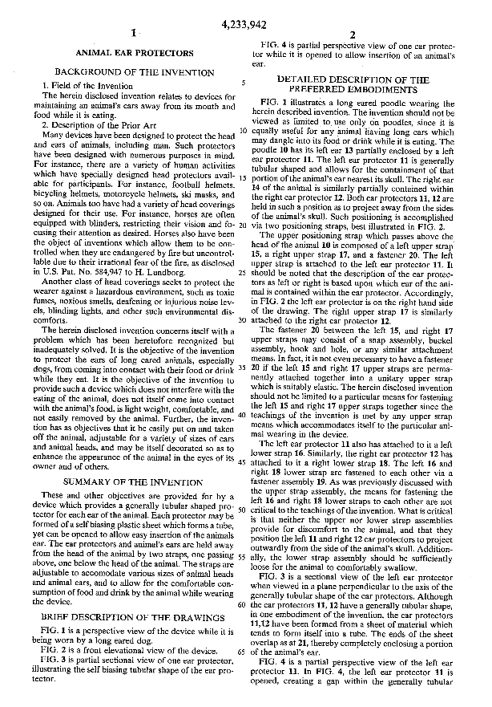
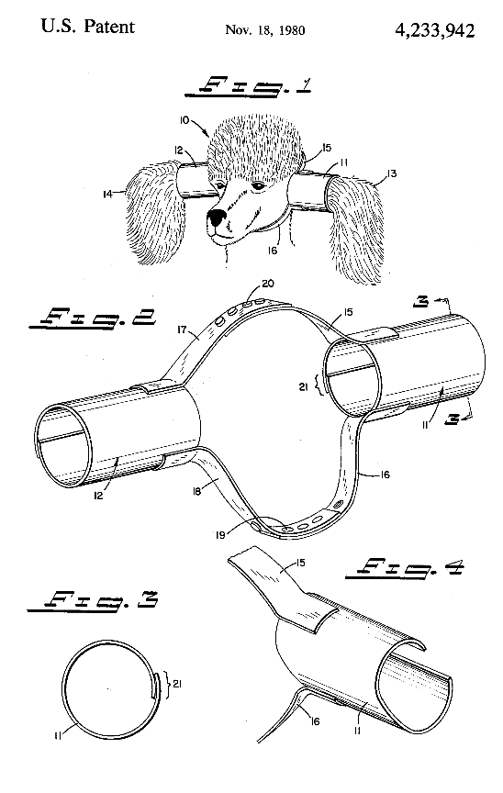
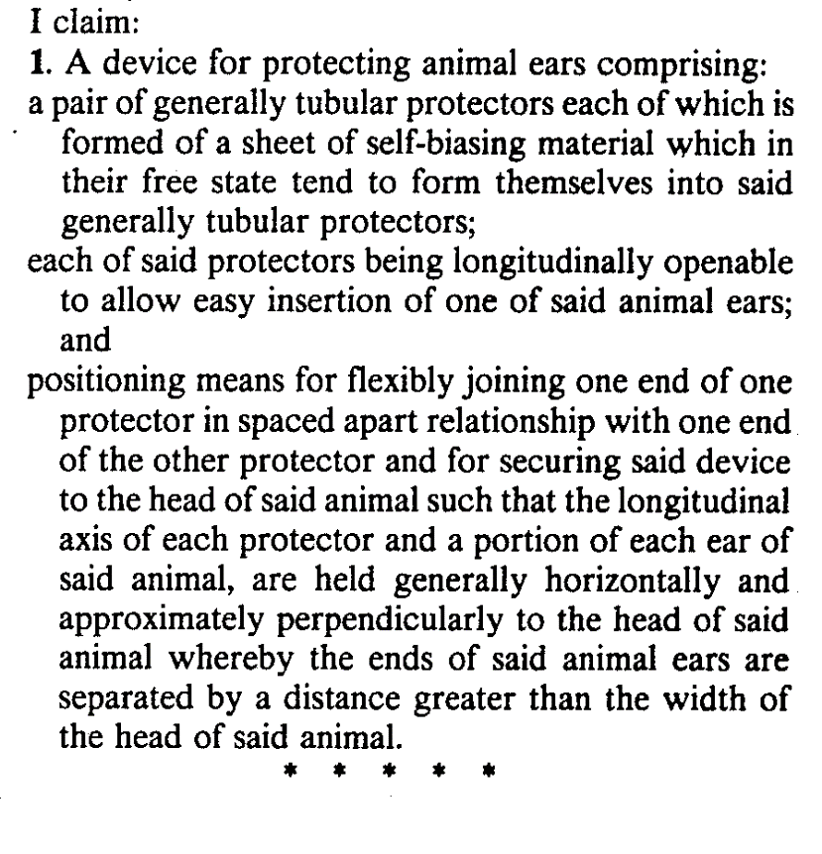
Parts of a Patent
Specification
The part of the patent that describes the invention
Drawings
The part of the patent that shows what the invention looks like
Claims
The part of the patent that defines and limits exactly what the invention does

Slide 15
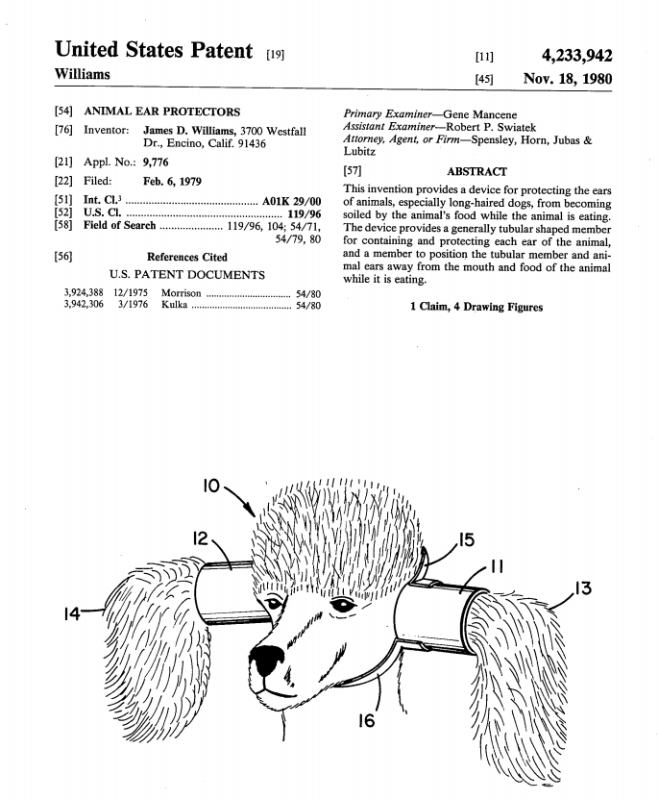
Parts of a Patent
Inventor
Name of the person or people who came up with the invention
Answer the following:
Patent Number
Each patent gets its own number
What is the title of the patent? ____________________________
What is the patent number? ____________________________
Who is the first named inventor?_________________________________________________
4. What is this invention about? ____________________________________________________________________________________
Patent Date
Date when the invention becomes patented
Abstract
Paragraph that explains briefly what the invention is and how it works
Title
Name of the invention
Drawings
Pictures that help show how the invention works

Slide 16
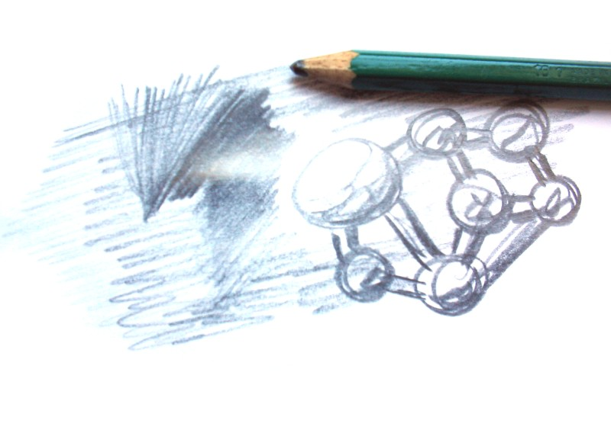
A focus on claims
Now it’s Your Turn – Draw the Following Claim:
1. A fabric towel mask for blocking ultraviolet rays of a sun, comprising:
a rectangular shaped material having opposing end edges, opposing side edges, and top and bottom surfaces;
at least one eye slit in the material for providing vision through the material, the eye slit being positioned to register with eyes of a user when the material is placed over the user’s face; and
at least one breathing slit in the material for providing breathing through the material, the breathing slit being positioned to register with a breathing opening of the user when the material is placed over the user’s face.
Notes:
Photo taken by Felipe Micaroni Lalli (available at https://commons.wikimedia.org/wiki/File:Aofhfeworewour2.jpg), which his licensed under the Creative Commons Attribution-Share Alike 2.5 Generic license (available at https://creativecommons.org/licenses/by-sa/2.5/deed.en).

Slide 17
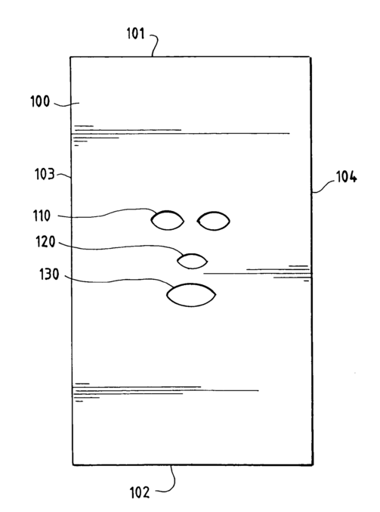
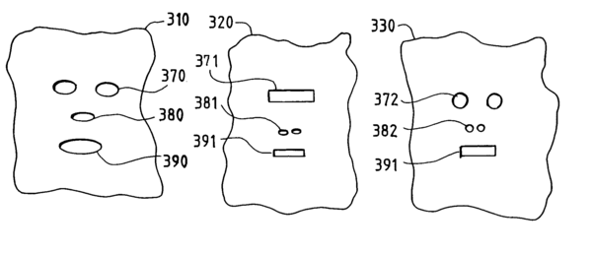
A focus on claims
Now it’s Your Turn – Draw the Following Claim:
Did your drawing look like the sun mask towel?
US Patent No. 7,051,371
1. A fabric towel mask for blocking ultraviolet rays of a sun, comprising:
a rectangular shaped material having opposing end edges, opposing side edges, and top and bottom surfaces;
at least one eye slit in the material for providing vision through the material, the eye slit being positioned to register with eyes of a user when the material is placed over the user’s face; and
at least one breathing slit in the material for providing breathing through the material, the breathing slit being positioned to register with a breathing opening of the user when the material is placed over the user’s face.
or

Slide 18
How to think like an inventor

Slide 19
Think like an inventor
Remember the Sun Mask Towel?
Includes eye, nose, and mouth slits to allow users to see, speak, and breathe easily while blocking UV rays
The Sun Mask Towel
List three ways you would improve the Sun Mask Towel
Draw at least one of your improvements
Share your ideas with the group!
Notes:
Photo taken by Felipe Micaroni Lalli (available at https://commons.wikimedia.org/wiki/File:Aofhfeworewour2.jpg), which his licensed under the Creative Commons Attribution-Share Alike 2.5 Generic license (available at https://creativecommons.org/licenses/by-sa/2.5/deed.en).

Slide 20
What did you invent?

Slide 21

Thank you!
You are on your way to getting your patch!

