Slide 1

The importance of Intellectual Property to the success of business
January 2020

Slide 2

Agenda:
Patent Overview – protect useful and new “inventions”
Practical Tips for Inventors
Overview of Other Types of IP
Trade Secrets – protect confidential business information
Copyrights – protect original works of authorship
Trademarks – designate the source of goods or services
Business and Competitive Value of IP

Slide 3
PATENT OVERVIEW

Slide 4
Purpose of Patent Protection
Promote the progress of science and the useful arts by encouraging public disclosure of inventions.
Give inventors the exclusive right to their inventions for a limited time (generally, 20 years from file date)

Slide 5
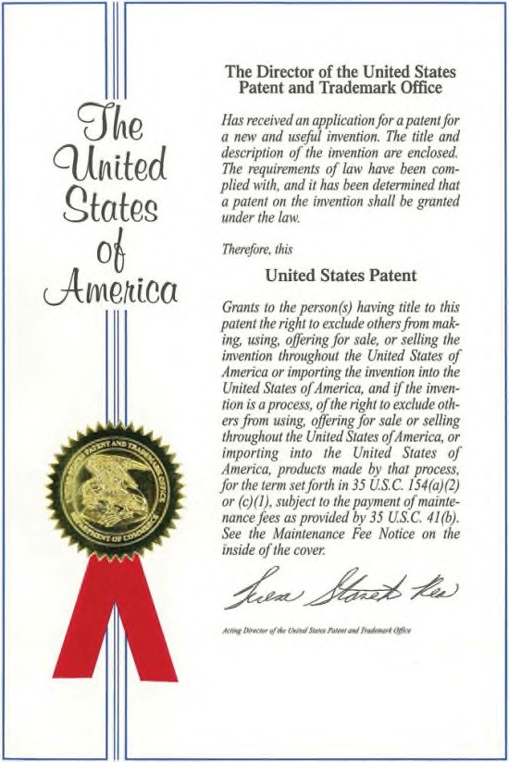
What is a Patent Right?
Time-limited right to exclude others from making, using, offering for sale, selling, or importing an invention for a limited time
Does not confer on owner right to practice invention.

Slide 6
Patents: The Basics
Constitution-based bargain between the inventor and the federal government (“legal monopoly”).
Invention must be new and non-obvious.
First inventor to file patent application has priority.
Patent term: twenty years after application filing date (generally).

Slide 7
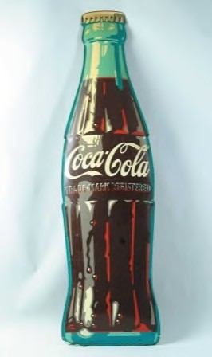
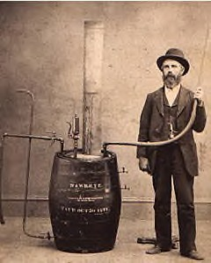

Types of Patents
Plant Design
Utility Patents (most common)
Utility
Covers machines, products, chemical compounds, computer software, processes, methods, etc.

Slide 8
Types of Patents (cont’d.)
Provisional
Placeholder application – preserve priority date
Minimal investment – low cost and few formal requirements
Not examined and will never issue as a patent
Must file non-provisional application within 12 months
Non-provisional application can add information to the provisional
Non-provisional
Greater investment – more expensive and must satisfy formal requirements
Undergoes examination and can issue as a patent

Slide 9
Key Parts of a Patent
Claims ̶ at the end of the patent, define the
boundaries of the right to exclude.
Filing date ̶ establishes priority and patent term.
Inventors ̶ errors can be corrected, but best to
get it right from the beginning.

Slide 10
Key Steps in Obtaining a Patent
File Patent Application with USPTO
Foreign Filing (if necessary) within 12 months
Publication at 18 months
Prosecute Patent Application until Grant

Slide 11
Patent Prosecution
Application is filed with USPTO
Examiner is assigned, who will search prior art
Most patents receive at least one rejection
Continue to modify or discuss with Examiner over time until either issued or abandoned

Slide 12
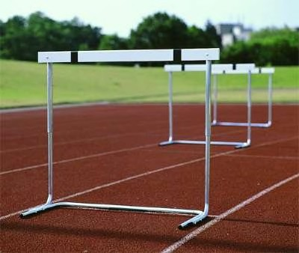
Patentability Requirements
Patent-eligible subject matter
Useful
Novel
Non-obvious
Written description requirement

Slide 13
First to… – Invent? – File ?
Old US system was first to invent
Changed to First to File with America Invents Act in September 2011
Patents filed before that date are treated under prior law

Slide 14
Identifying Patent Eligible Inventions
In order to have reasonable a chance at obtaining patent protection for a software product or service, the software must be novel and non-obvious, and should also:
(a) involve a technical implementation;
(b) solve a technological problem (i.e., a problem arising out of technology, such as a limitation of current technology) or improve upon current technological solutions for addressing a problem; and
(c) include a useful or practical application beyond merely calculating and providing a result, or merely organizing and presenting information using conventional means (i.e., conventional in the sense that there is nothing novel or inventive about how the information is collected, processed, or presented).

Slide 15
US and International Patents
Patent generally only applies in the country in which it was filed
Inventor can apply for patents in other countries
International patent prosecution is very expensive, tend to pick only relevant markets

Slide 16
Patent Infringement
Infringement occurs if another person:
Makes the invention in the U.S.
Uses the invention in the U.S.
Sells the invention in the U.S.
Offers to Sell the invention in the U.S. OR
Imports the invention into the U.S.

Slide 17
Patent Infringement Remedies
Damages ̶ lost profits or reasonable royalty.
Injunctive relief.
Damages may be enhanced UP TO 3X if infringement was willful.
If you need to search for patents, contact the legal group for assistance.
Attorneys’ fees in “exceptional” cases.

Slide 18
PRACTICAL TIPS FOR INVENTORS

Slide 19
Disclosures
Generally, do NOT publicly disclose new and novel ideas before filing a patent application
Avoid public disclosure bars (1 year)
Maintain foreign patent rights
Any disclosure of an invention to a third party should be covered by an NDA

Slide 20
Documenting Inventions for Patenting
Prepare Invention Disclosure Form that includes these details:
Problem you are trying to solve
Closest existing solutions and why they fail to solve the problem
Technical description of invention highlighting key aspects of your solution and advantages of over existing solutions
Details on demo or existing implementation of invention
Whether invention has been publicly disclosed or expected date of first public disclosure
Any plans to release invention as open source
Product roadmap – details on product release that will include invention
Name(s) and contact information for all Inventors

Slide 21
Factors Favoring Patent Protection
Invention solves a problem
Invention improves upon existing technology (even incremental improvement)
Competitors would want to use the invention
Invention is detectable
Invention is not easily designed around
Invention has not been disclosed outside of Doosan
Invention appears to satisfy subject matter eligibility requirements
Technical solution to technical problem
Improves functioning of a computer
Non-conventional and non-generic arrangement of known, conventional pieces
Meaningful limitations

Slide 22
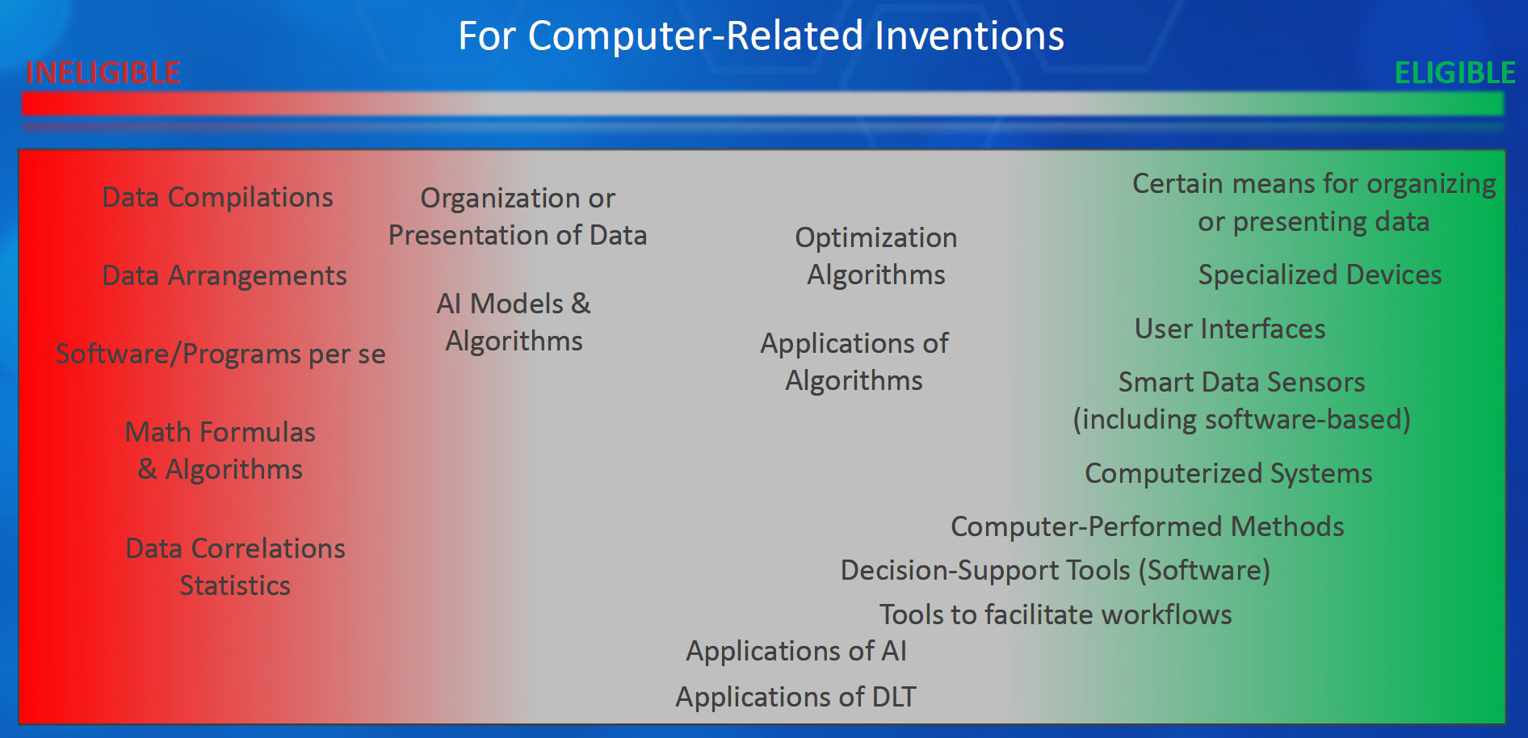
Spectrum of Patentability

Slide 23
Timeline for Patent Submissions
Take action early and contact legal to expedite patent filing process
A patent application should be filed as soon as the inventor(s) can describe how to achieve a desired end (e.g., provide enough detail for others to make or use the invention)
Benefit of early filing
Establish priority date and avoid intervening prior art
First-to-File system – beat others to the Patent Office
Public disclosures can forfeit foreign rights
U.S. allows a one-year grace period after public disclosure, BUT:
Third party can file application directed to improvement on your disclosed invention
Other countries offer no grace period

Slide 24
Patents: Recap
Legal monopoly (right to exclude)
Utility patents protect a new and useful process, machine, or composition of matter
Software inventions can be patented
Don’t Delay – File Early

Slide 25
QUESTIONS?

Slide 26
OTHER TYPES OF IP

Slide 27
Trade Secrets: The Basics
Must be a secret.
Owner must take reasonable measures to preserve secrecy.
Must provide a competitive advantage.
Misappropriation requires some improper act.

Slide 28
Trade Secret vs. Patent
Factors favoring patents
Susceptible to reverse engineering or independent discovery
Easily observed when in use
Invention unlikely to have significant value for more than 20 years
Appears patentable
Factors favoring trade secrets
Has been kept secret and can be maintained as a secret
Invention likely to have significant value for more than 20 years
Patentability is questionable

Slide 29
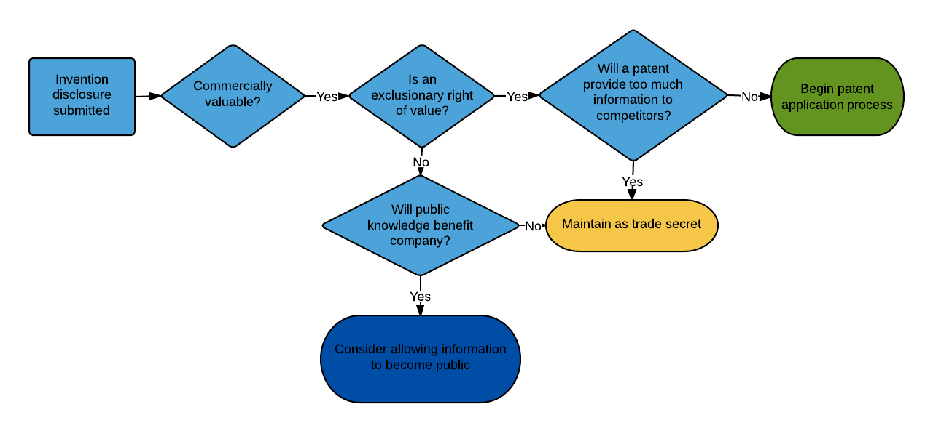
Trade Secret vs. Patent

Slide 30
Copyright: The Basics
Original work of authorship
Fixed in tangible form
Protects expression, not idea
Rights attach automatically upon creation of the work
Lengthy duration
Notes:
Fixed expression (work of authorship) is protected (not underlying ideas – those are covered by patents), protection is relatively weak compared to other forms of IP. That’s why the protection is automatic – everyone in room owns their schoolwork (notes and papers).
Prove copying by access plus substantial similarity – easy to establish that a song was popular on the radio (access) and so if a later song is similar to an earlier popular song, it’s a relatively easy target.
The Pretty Woman case was a 1994 US Supreme Court decision that 2 Live Crew’s version of Roy Orbison’s classic “Pretty Woman” was a fair use because it transformed the original into a parody. For duration – it can vary for older works (used to be life + 50); works for hire are a special case with specific requirements best left to IP attorneys.
When working as employee, you will likely sign agreements that transfer ownership of things you create to your employer.

Slide 31
The Most Famous Song in the World?
“Happy Birthday to You”
Copyright registered in 1935
Popularized through singing telegrams, musicals
Warner music owned it, but recently invalidated
Revenue for commercial use collected through ASCAP
Licenses and distributes royalties for member composers, authors, and publishers
Royalties had been $2M annually!
Notes:
Note that no one will come knocking on your door for royalties for singing the song with friends and family, but this is why the staff never sings the original song in restaurants
Invalidating suit involved lyrics for Good Morning to All – found that is all Warner owned

Slide 32
Trademarks: The Basics
Word, design, or other indicia.
Used in commerce.
Designates the source of goods or services.

Slide 33
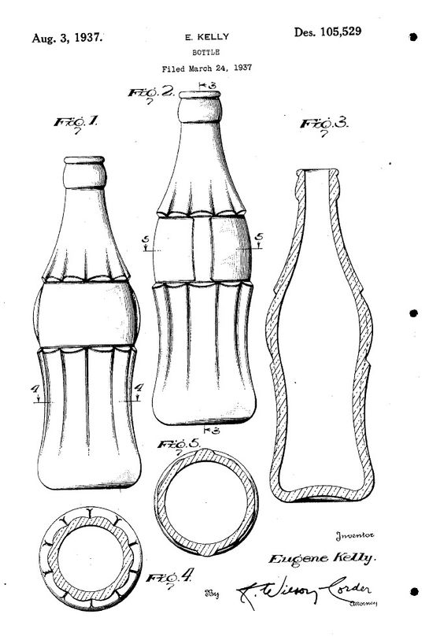
Overlapping IP Protection
Design Patent: Shape of bottle
Trade Secret: The “secret” formula
Trademark/Trade Dress:
Coca-Cola, Shape of Coke Bottle
Copyright: Advertising and Promotion

Slide 34
Software – IP Protectable?
Patentable? Yes, but recent case law has created challenges
Alice Corp. v. CLS Bank (2014)
Trade Secret: Yes, if kept secret
Copyright: Yes
Trademark: Unlikely to show a source of a good or service

Slide 35
Duration of IP Rights
Patent: 20 years from filing (generally)
Trade Secret: As long as it is kept secret, can be indefinite (e.g. Coca-Cola formula)
Trademarks: As long as renewed and continued to use in commerce, can be indefinite
Copyright: Life of author plus 70 years for an individual work

Slide 36
Which IP Protection Applies?
No
Designate Source?
No
New Aesthetic Feature?
No
Useful?
Yes
Yes
Yes
No
Design Patent
Secret?
New?
TM
©
Yes
Yes
Trade Secret
Utility Patent

Slide 37
BUSINESS AND COMPETITIVE VALUE OF IP

Slide 38







IP Goals Aligned with Business/Technical Strategy
Foundation for business relationships and collaboration
Deterrence against competitors and fast followers
Freedom to operate against strong incumbents
Encourage technology adoption
Strengthen innovation credibility
Create competitive differentiation
Reinforce incentives to innovate

Slide 39
Broad Range of IP Usage
Build “Innovation Currency” to achieve PCL balance against major patent licensors
Enhance contributions to joint development or industry aliances Promote Open Specifications with royalty free patent grants Seed ecosystem with community patent non-assertion pledges BOM Offset - commoditize components
License on Transfer (LOT) Agreement and other defensive aggregation strategies to mitigate patent risk

Slide 40
WHAT IF WE DID NOT HAVE INTELLECTUAL PROPERTY?
Notes:
Someone that innovates could spend a lot of their own money and time and launch a product, only to have someone else copy and sell it much cheaper.
Likely to invest time and money again?
Having the ability to protect your innovation and recoup financially – and make some profit – encourages innovation! In the case of patents, it helps everyone advance when the info is disseminated in the patent document and when the invention becomes free upon patent expiration.

Slide 41
HOW MUCH IS INTELLECTUAL PROPERTY WORTH?
Notes:
¾ of company worth is estimated to be IP

Slide 42
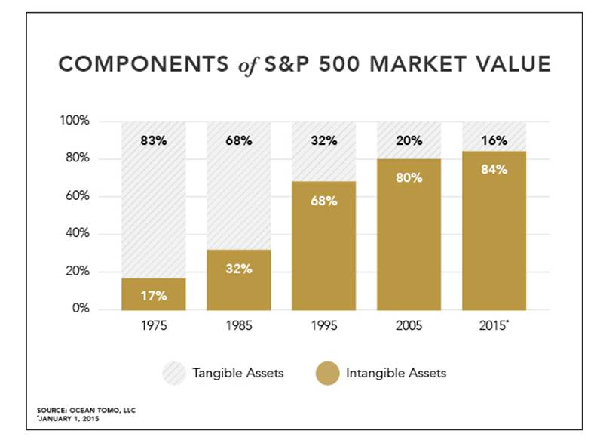

Slide 44
Take Away Messages
IP is valuable, and is key to competitiveness
Protect IP and leverage it wisely
$$$
Market share
Reputation
Get to know IP attorneys; we would rather find out about issues in advance than after the fact

Slide 45
QUESTIONS?

