Slide 1
INVENTING

Slide 2
QUESTIONS
What is an invention?
How do I invent?
What is a patent?
How do I get one?

Slide 3

AN INVENTION IS AN IDEA

Slide 4
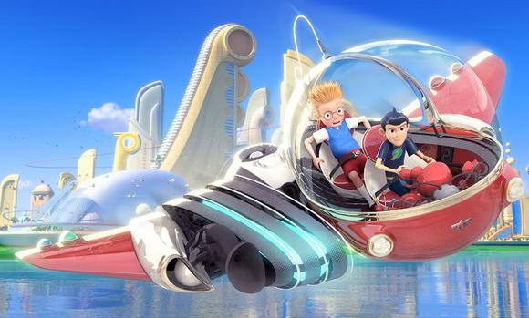
WILL ANY IDEA WORK?
The idea has to be realistic.
Sorry, no time machines.
Image from Sprywolf used per CC BY-SA 3.0 license

Slide 5
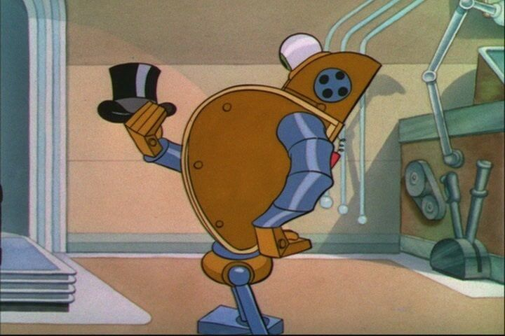
WILL ANY IDEA WORK?
The idea has to be definite.
It’s not enough to say that you thought of the idea for a robot butler. You have to explain how the robot butler would work.
Image from Dai-Kon Hal used per CC BY-SA 3.0 license

Slide 6
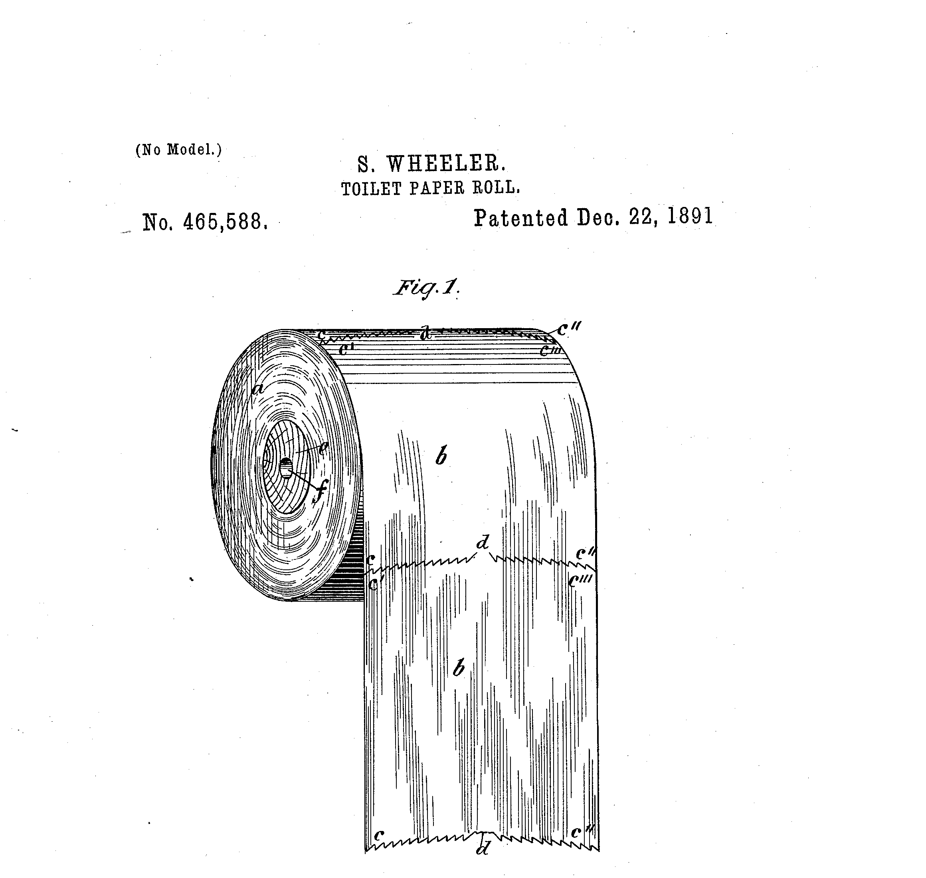
WILL ANY IDEA WORK?
The idea has to be new.
For example, the toilet paper roll has already been invented!
Public domain image courtesy of the United States Patent and Trademark Office

Slide 7
BRAND NEW THINGS
One way something can be ‘new’ is to be a brand new thing.

Slide 8
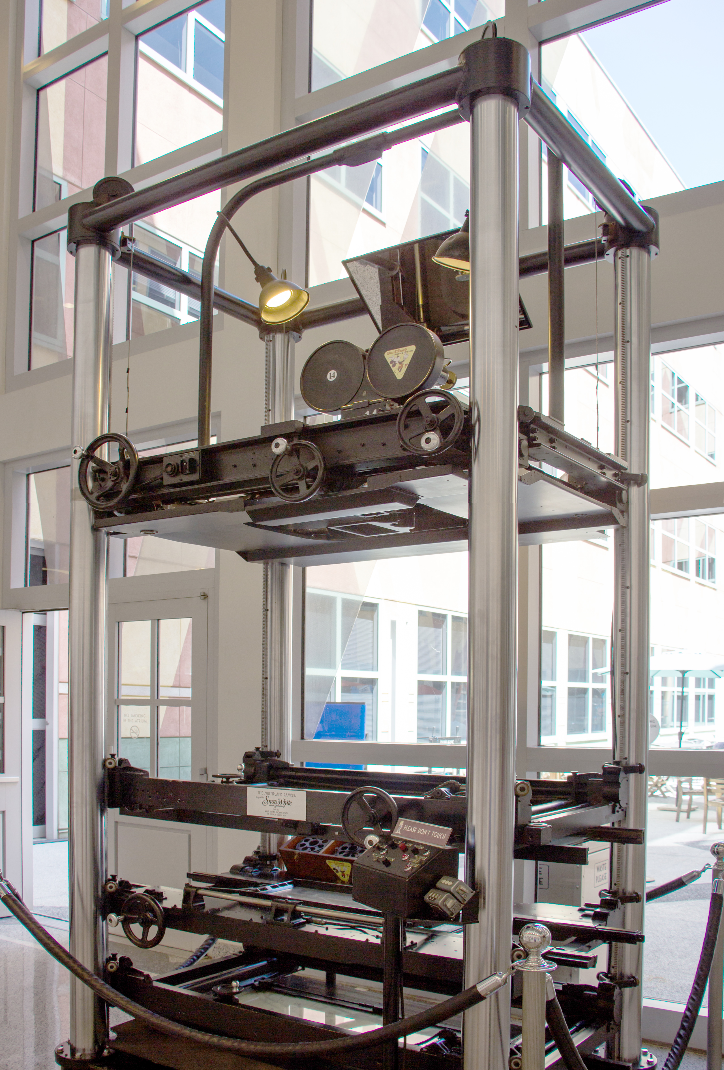
BRAND NEW THINGS
Image from HarshLight used per CC BY 2.0 license

Slide 9
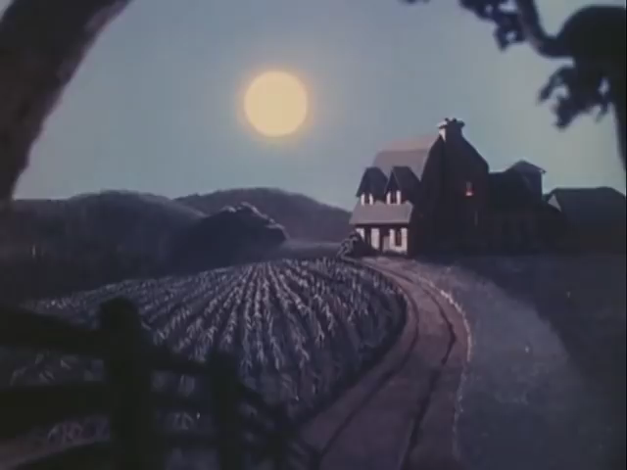
BRAND NEW THINGS
This copyrighted video has been published by Disney and is used for educational purposes consistent with United States copyright laws

Slide 10
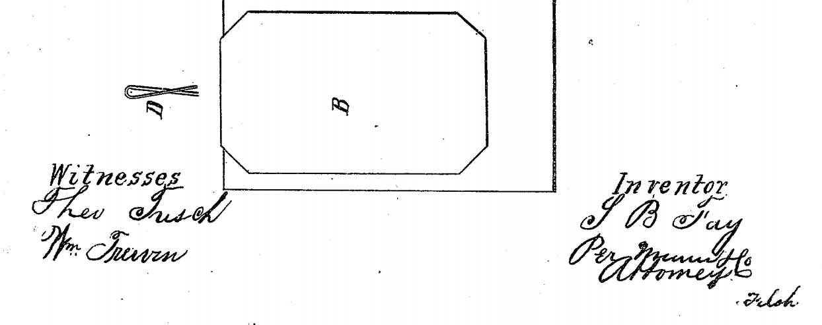
IMPROVEMENTS TO EXISTING THINGS
Another way something can be new is to be an improvement to something.
It took three inventors to get the modern paper clip!
Public domain image courtesy of the United States Patent and Trademark Office

Slide 11
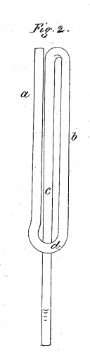
IMPROVEMENTS TO EXISTING THINGS
Another way something can be new is to be an improvement to something.
Public domain image courtesy of the United States Patent and Trademark Office

Slide 12
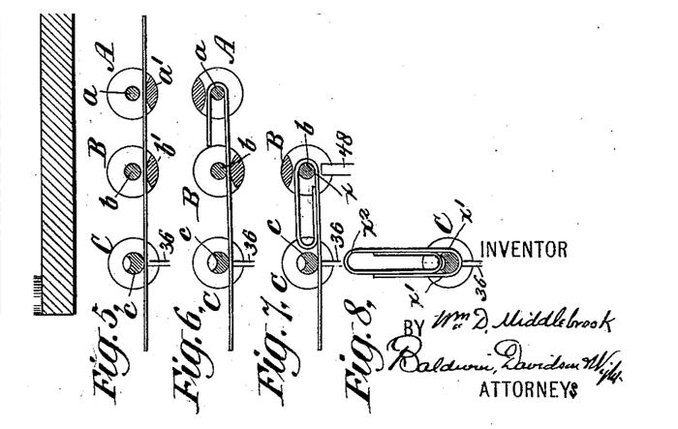
IMPROVEMENTS TO EXISTING THINGS
Another way something can be new is to be an improvement to something.
Public domain image courtesy of the United States Patent and Trademark Office

Slide 13
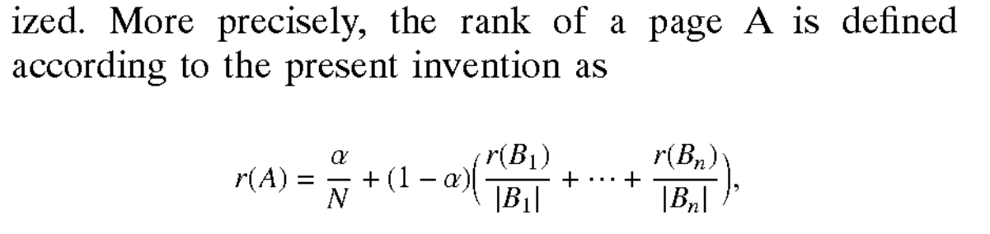
IMPROVEMENTS TO EXISTING THINGS
Another way something can be new is to be an improvement to something.
Before Google, it was very hard to search on the Internet. Then, Larry Page came up with just a little bit of math:
Public domain image courtesy of the United States Patent and Trademark Office

Slide 14
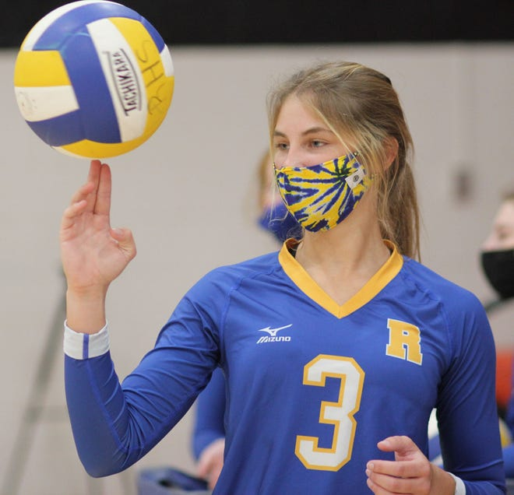
NEW USES OF OLD THINGS
Another way something can be new is to be a new use for an old thing.
These are uncommon because most new uses are considered “obvious.”
This copyrighted photo has been published by The Daily News and is used for educational purposes consistent with United States copyright laws

Slide 15
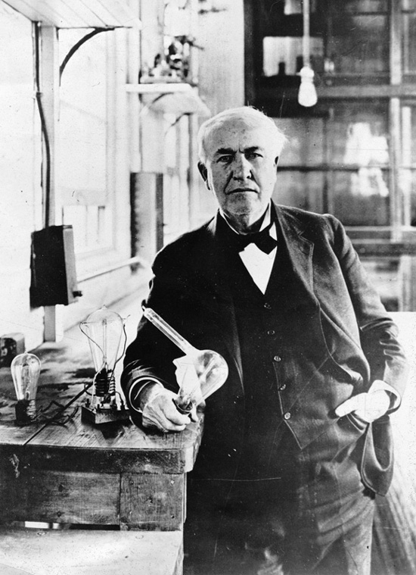
HOW DO I INVENT?
You might think of Thomas Edison in his garage, working day and night to perfect the light bulb.
Public domain image courtesy of the United States Department of State

Slide 16
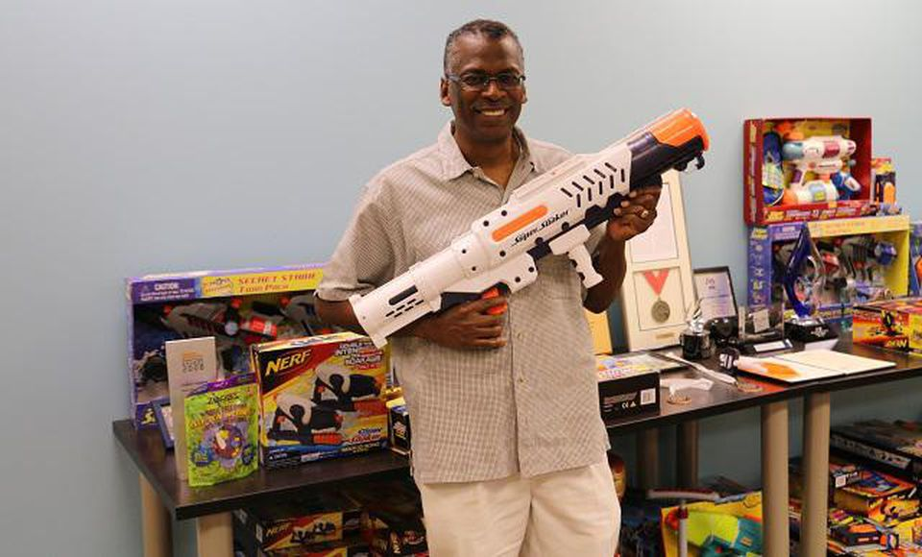
HOW DO I INVENT?
Some inventions are still made this way. Lonnie Johnson worked for NASA and invented the Super Soaker® in his basement!
This copyrighted photo has been published by Forbes and is used for educational purposes consistent with United States copyright laws

Slide 17
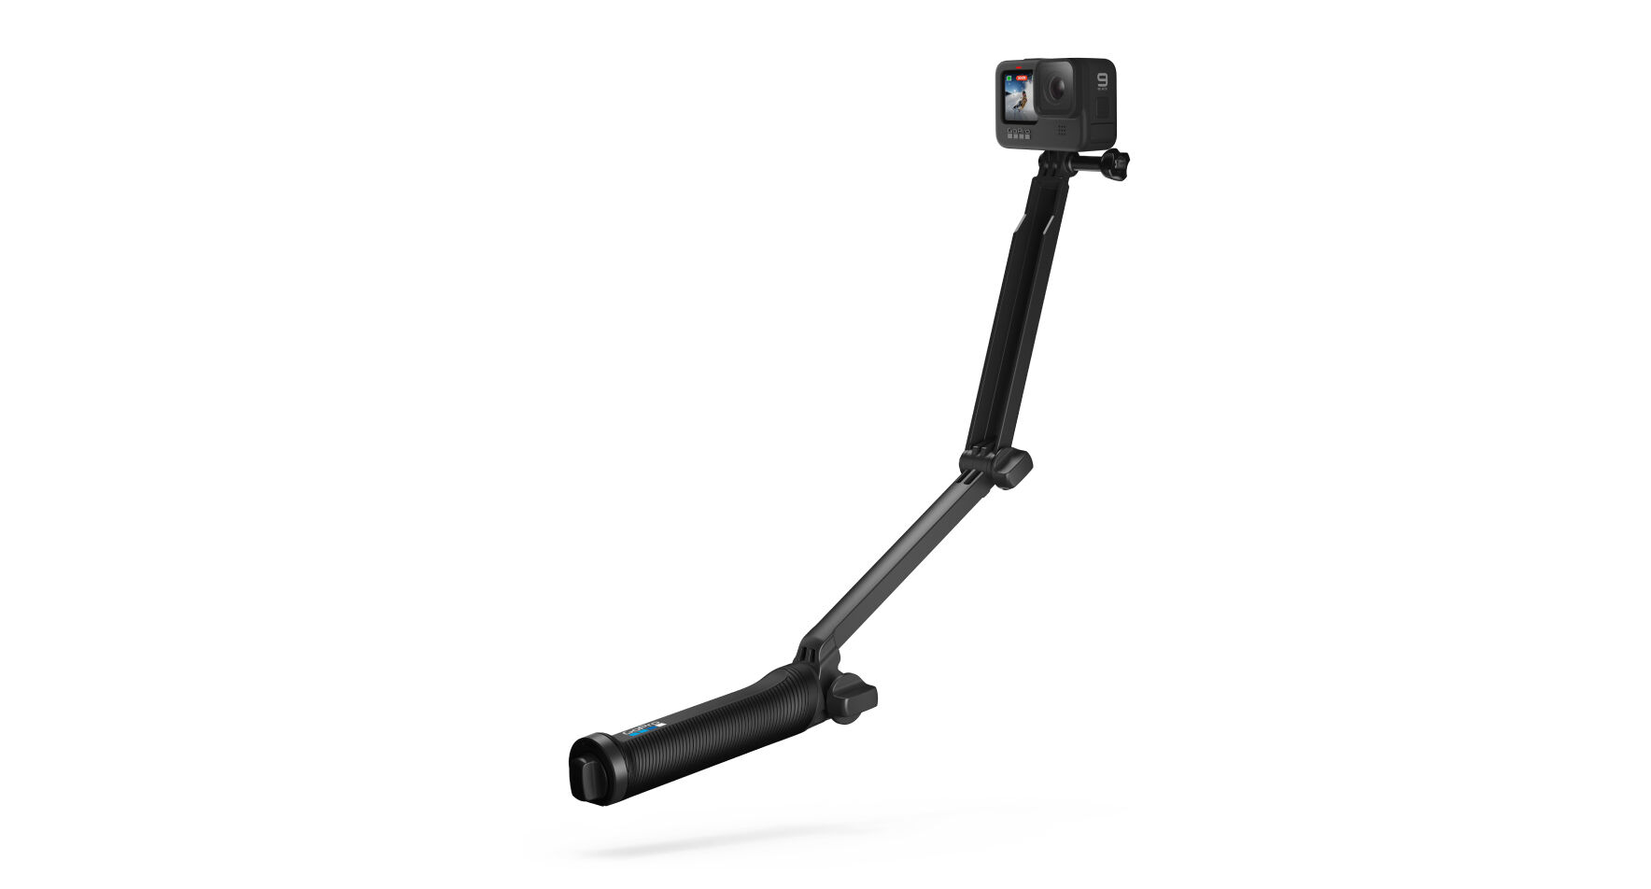
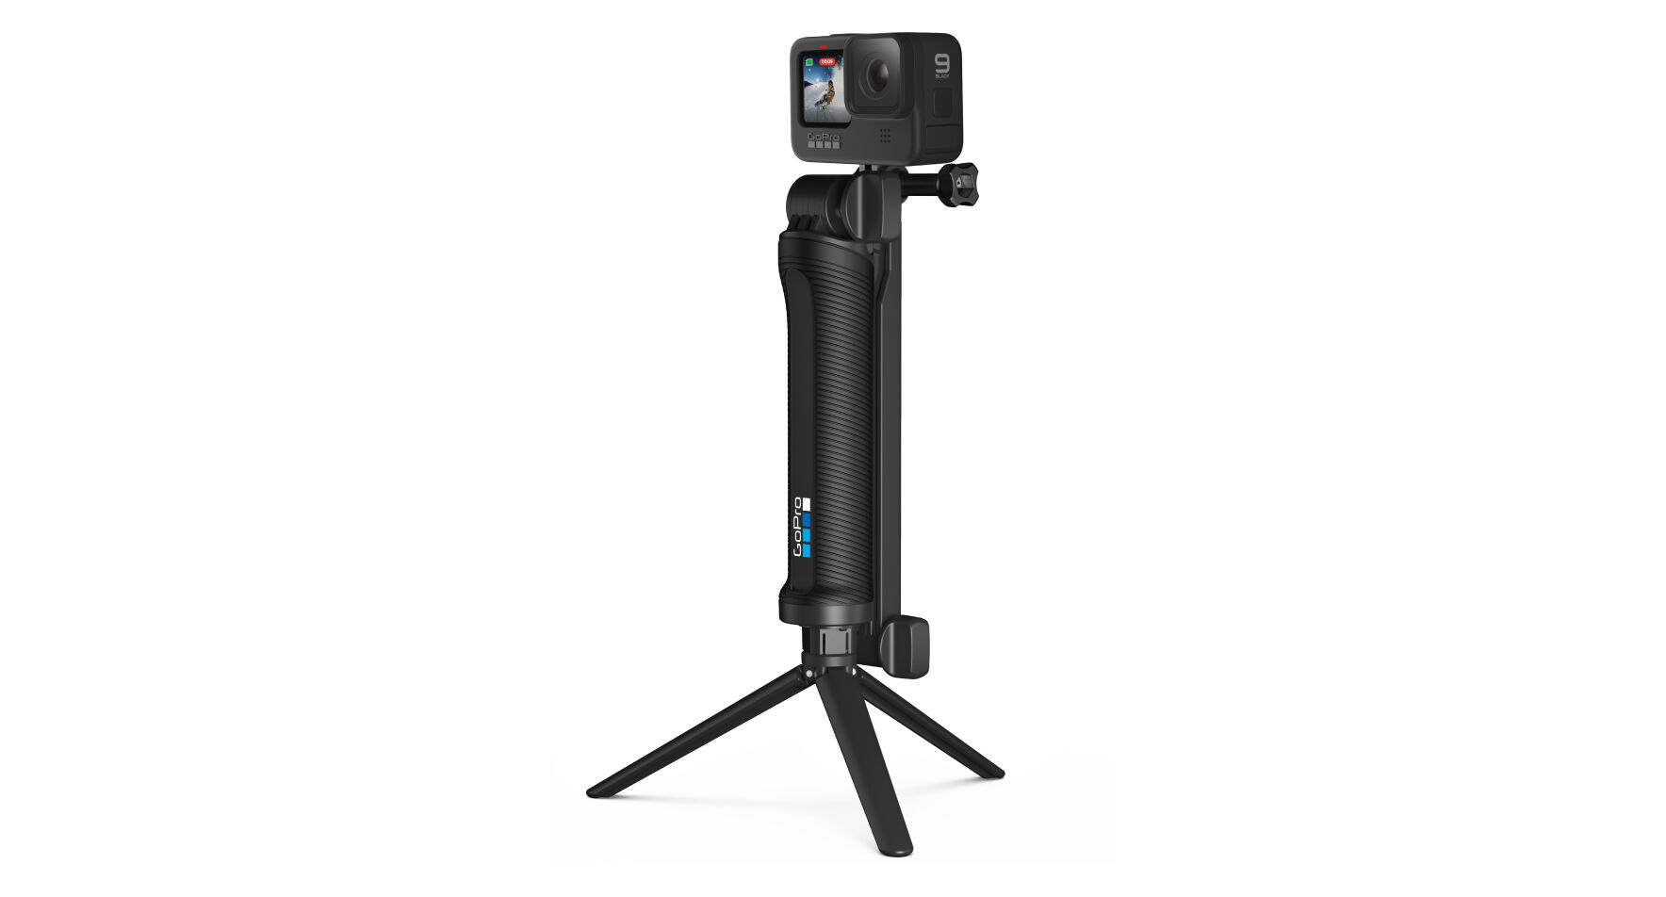
HOW DO I INVENT?
But you don’t have to do it alone!
Nick Woodman collaborated with 2 friends to develop a 3-way tripod.
These copyrighted photos have been published by GoPro and are used for educational purposes consistent with United States copyright laws

Slide 18
HOW DO I INVENT?
Many modern inventions come from collaboration.
A team of 8 Disney® engineers improved fireworks in 1992.

Slide 19
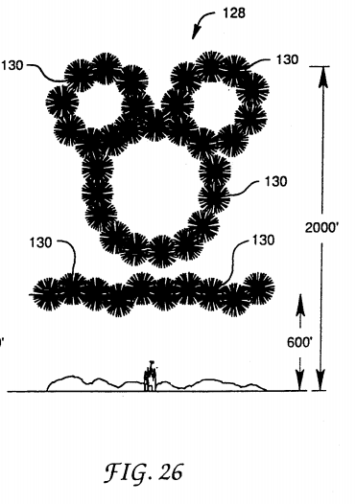
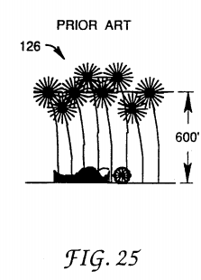
HOW DO I INVENT?
Many modern inventions come from collaboration.
Public domain images courtesy of the United States Patent and Trademark Office

Slide 20
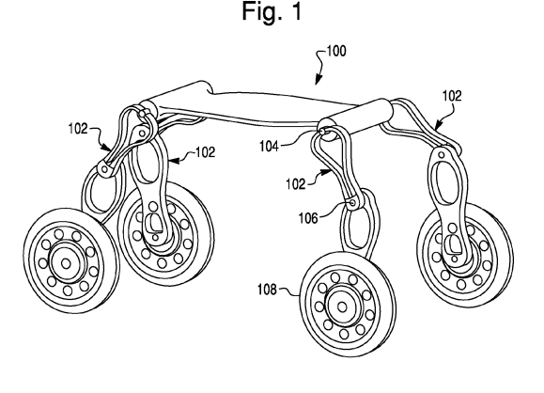
HOW DO I INVENT?
Many modern inventions come from collaboration.
A team of 4 NASA engineers improved a new robot in 2008.
Public domain image courtesy of the United States Patent and Trademark Office

Slide 21
HOW DO I INVENT?
Many modern inventions come from collaboration.
Over 20,000 different inventions allow smartphones to work today!

Slide 22
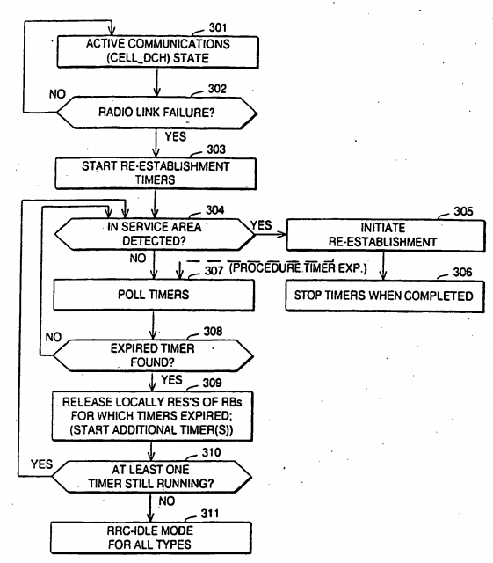
HOW DO I INVENT?
Public domain image courtesy of the European Patent Office

Slide 23
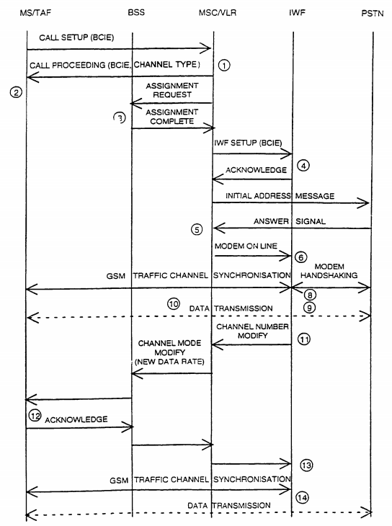
HOW DO I INVENT?
Public domain image courtesy of the European Patent Office

Slide 24
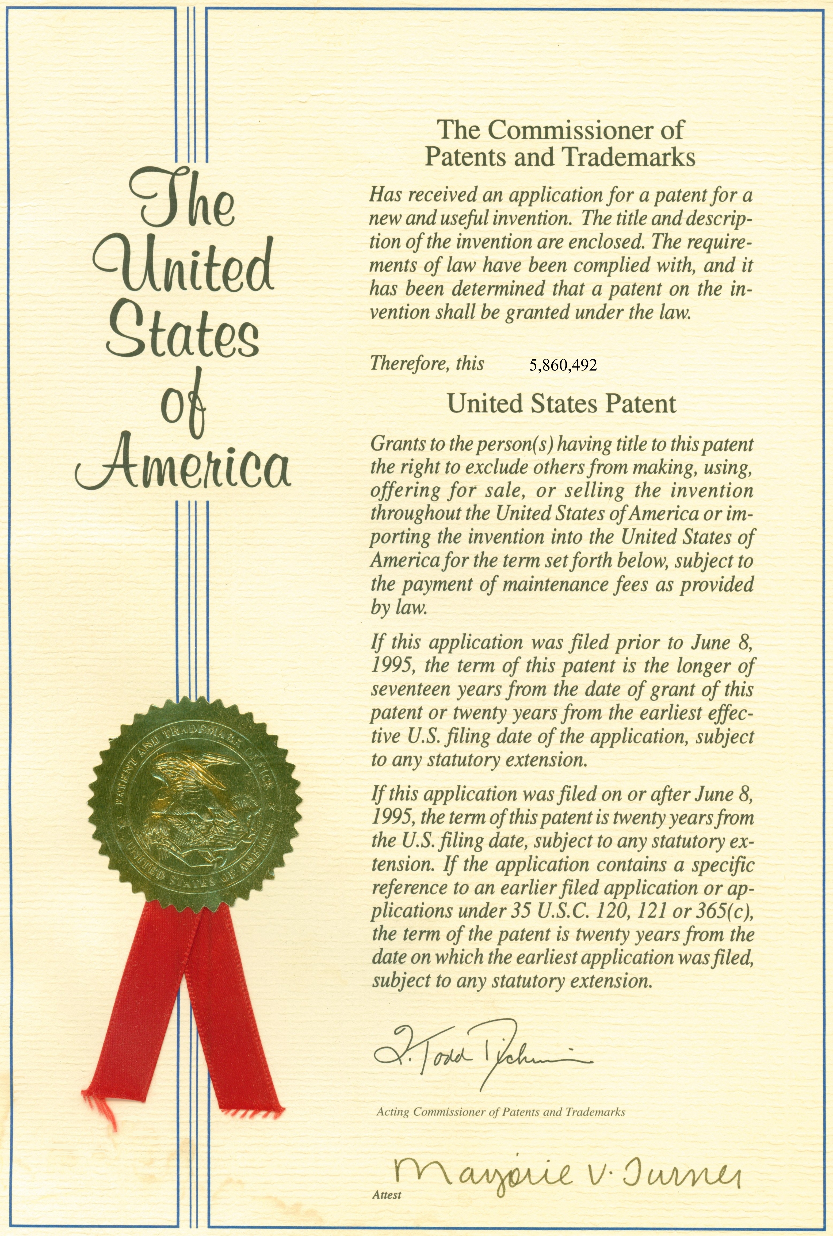
WHAT IS A PATENT?
Public domain image courtesy of the United States Patent and Trademark Office

Slide 25
WHAT IS A PATENT?
Device
System
Method
‘Article of Manufacture’
Design

Slide 26
WHAT IS A PATENT?
A device is a new machine.

Slide 27
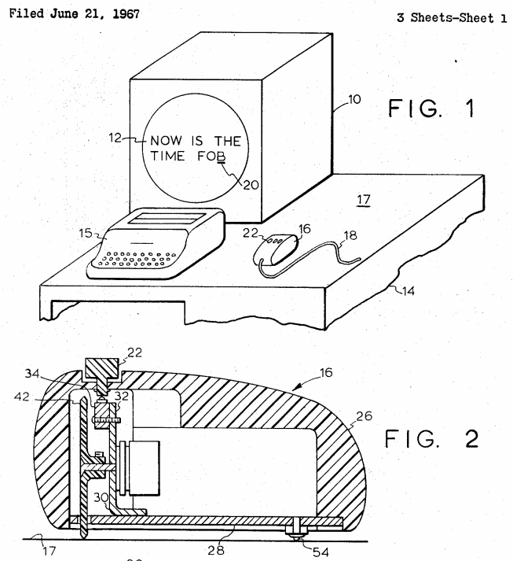
WHAT IS A PATENT?
Public domain image courtesy of the United States Patent and Trademark Office

Slide 28
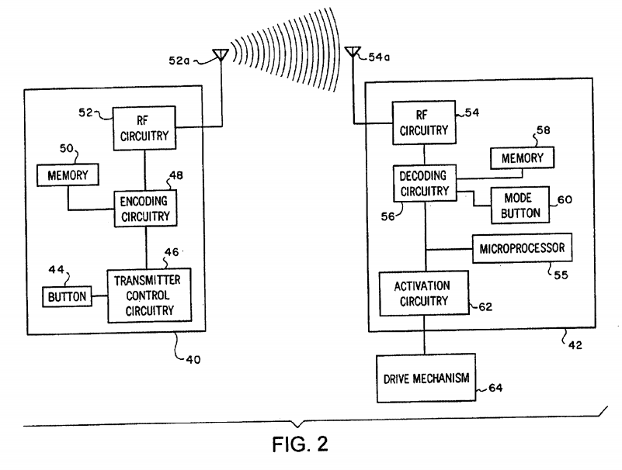
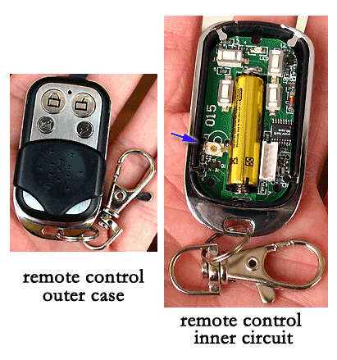
WHAT IS A PATENT?
Public domain image courtesy of the United States Patent and Trademark Office
Image from Winxpcn used per CC BY-SA 3.0 license

Slide 29
WHAT IS A PATENT?
A system is a collection of devices that work together.

Slide 30
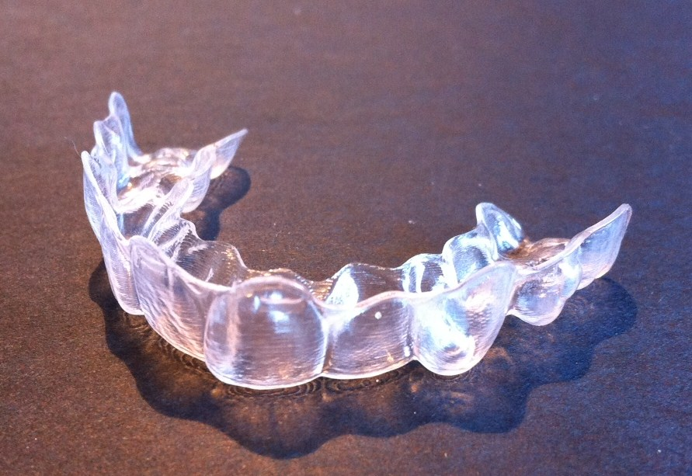
WHAT IS A PATENT?
Image from Smikey Io used per CC BY-SA 3.0 license

Slide 31
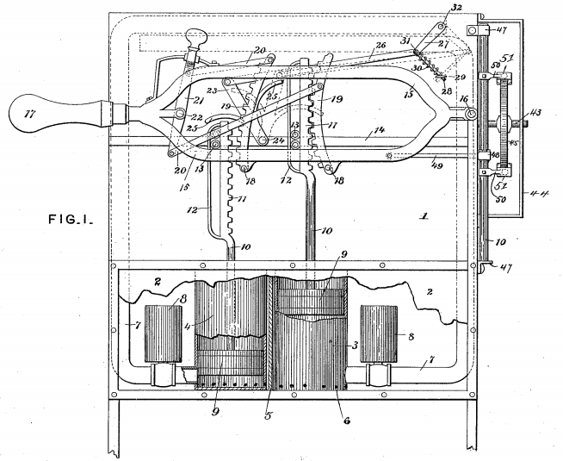
WHAT IS A PATENT?
Public domain image courtesy of the United States Patent and Trademark Office

Slide 32
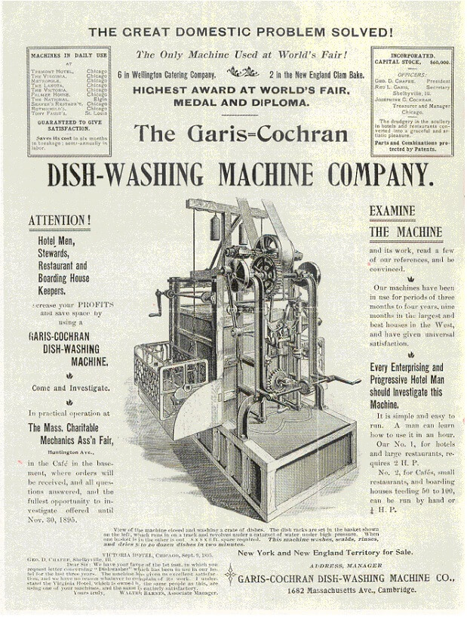
WHAT IS A PATENT?
Public domain image courtesy of the United States Patent and Trademark Office

Slide 33
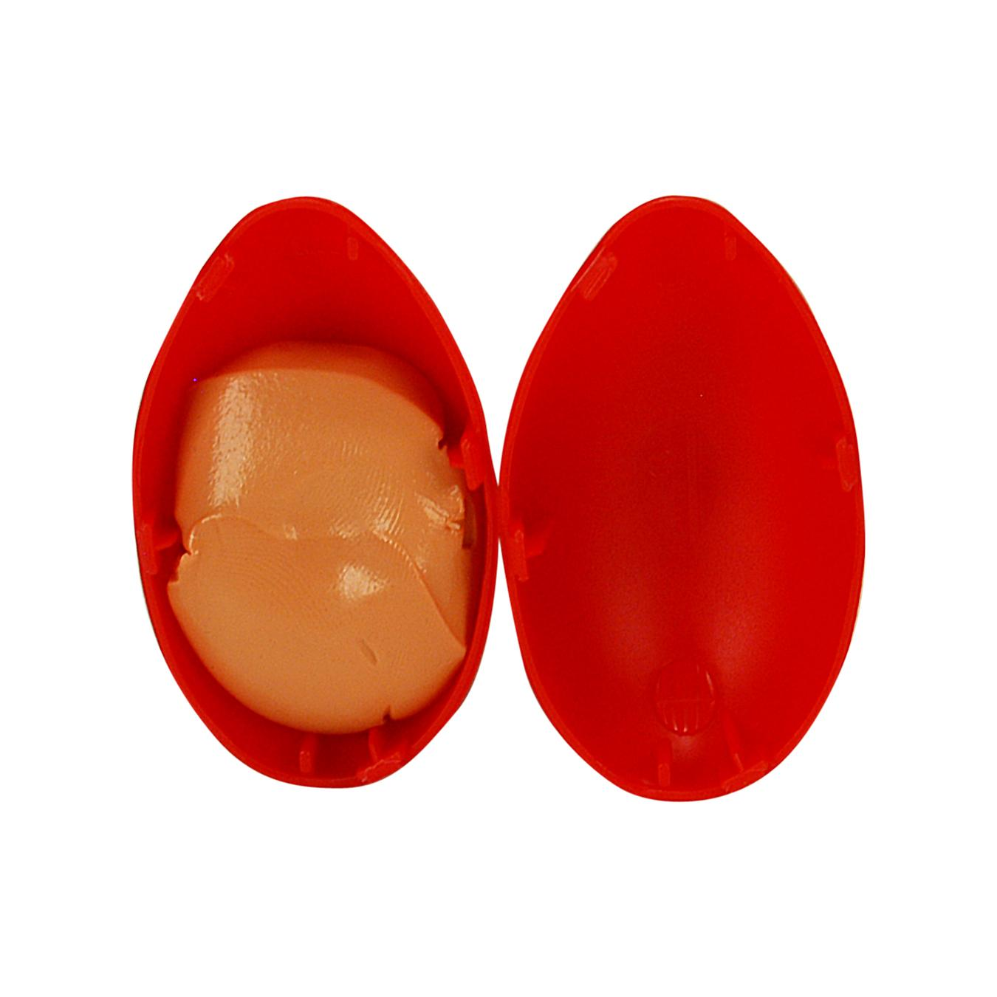
WHAT IS A PATENT?
A method is a set of steps to perform.
This copyrighted photo has been published by Mast General Store and is used for educational purposes consistent with United States copyright laws

Slide 34
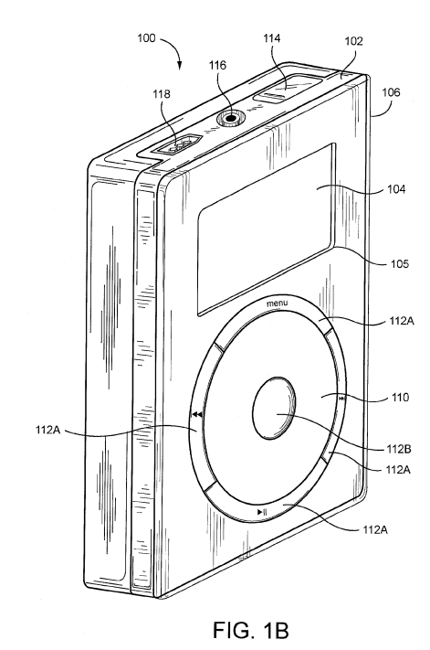
WHAT IS A PATENT?
Public domain image courtesy of the United States Patent and Trademark Office

Slide 35

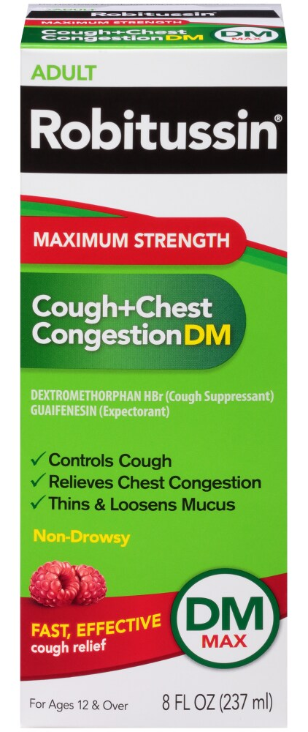
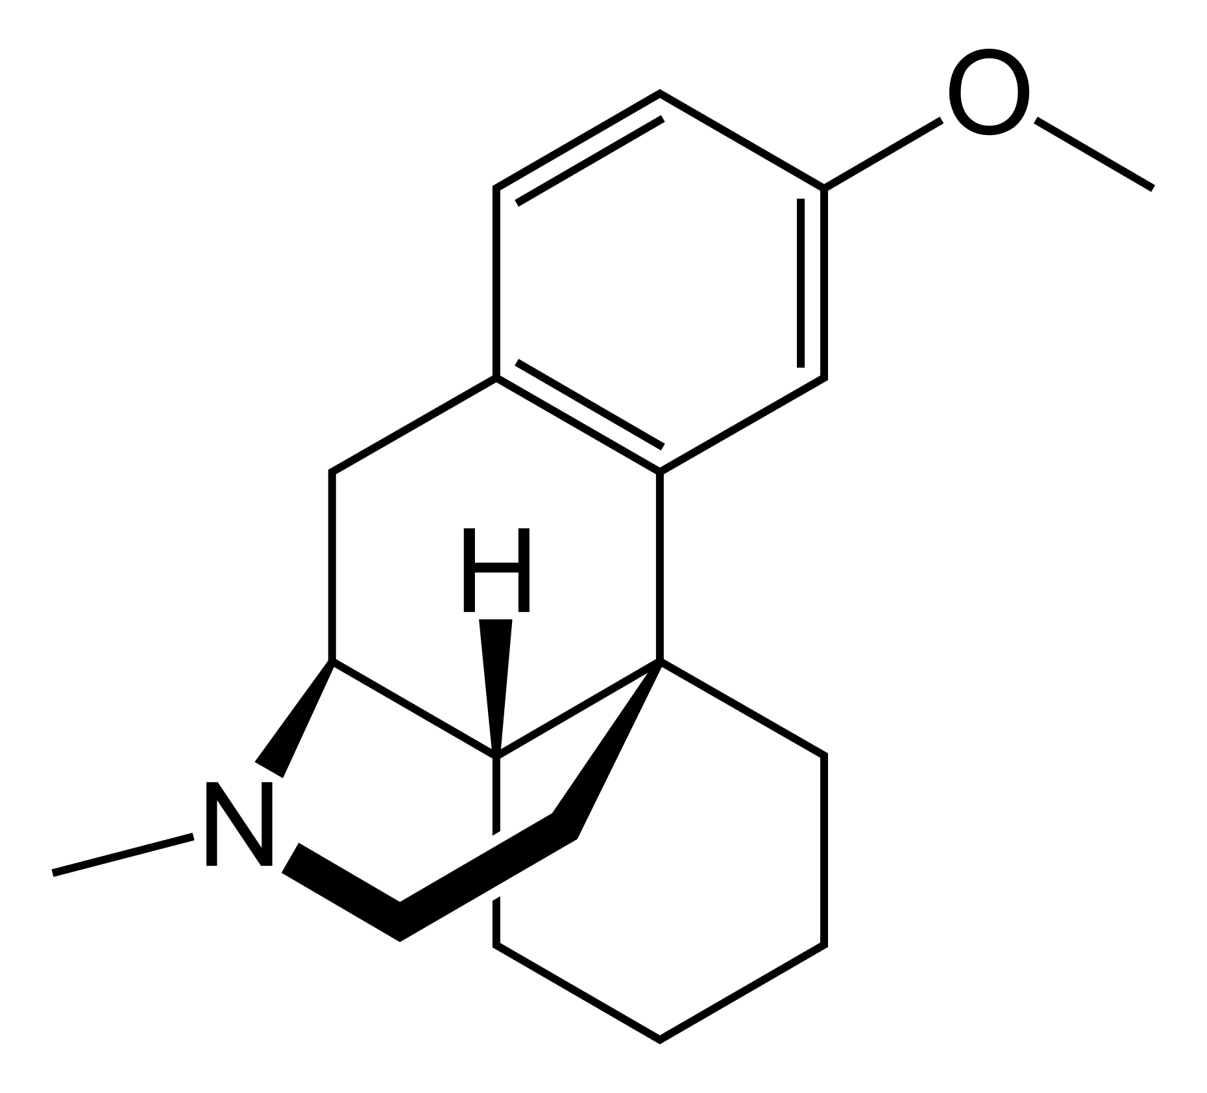
WHAT IS A PATENT?
An ‘article of manufacture’ is usually a new chemical or mixture.
Public domain image courtesy of Fvasconcellos
This copyrighted photo has been published by Ralphs and is used for educational purposes consistent with United States copyright laws

Slide 36
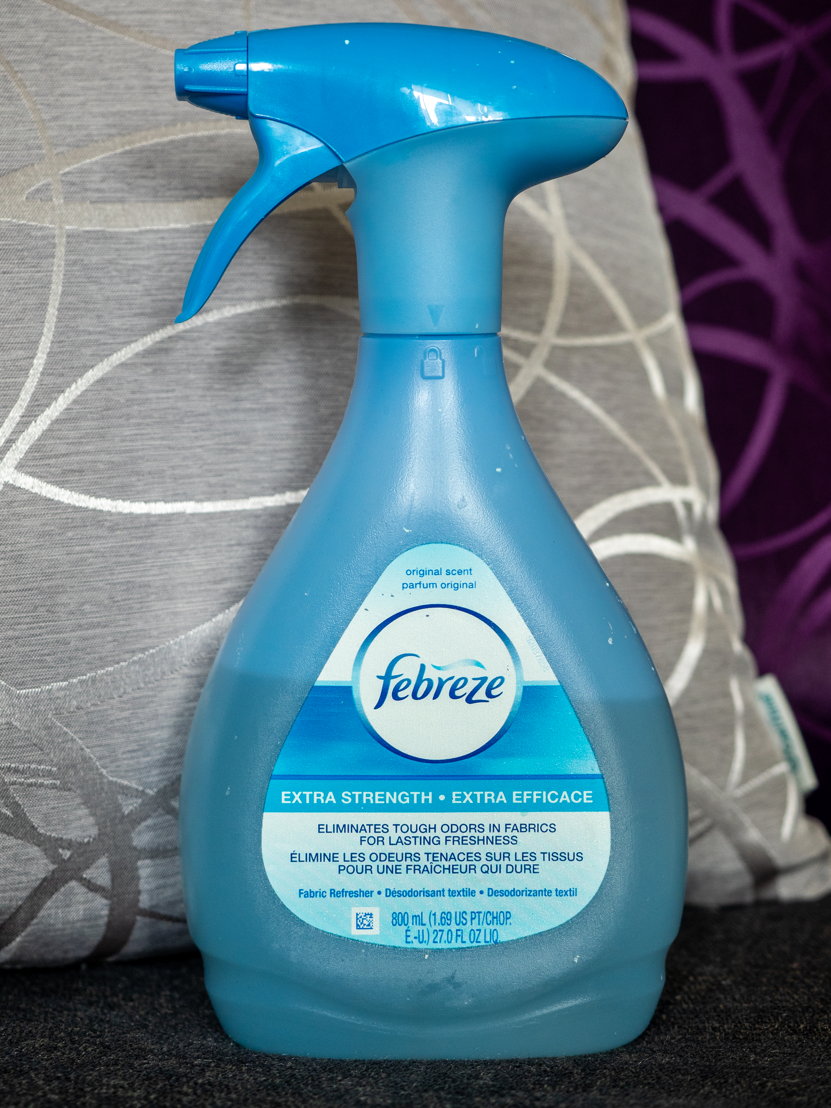
WHAT IS A PATENT?
Image from Ajay Suresh used per CC BY 2.0 license

Slide 37
WHAT IS A PATENT?
A design patent protects how something looks.

Slide 38
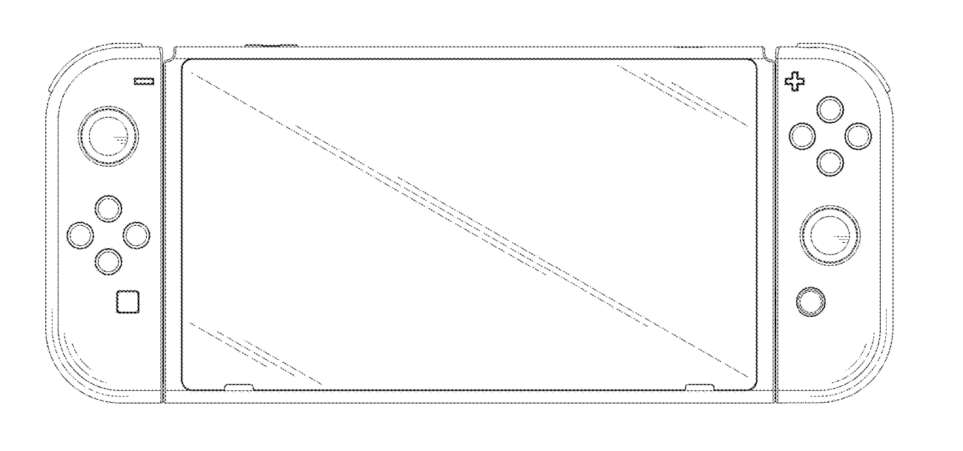
WHAT IS A PATENT?
Public domain image courtesy of the United States Patent and Trademark Office

Slide 39
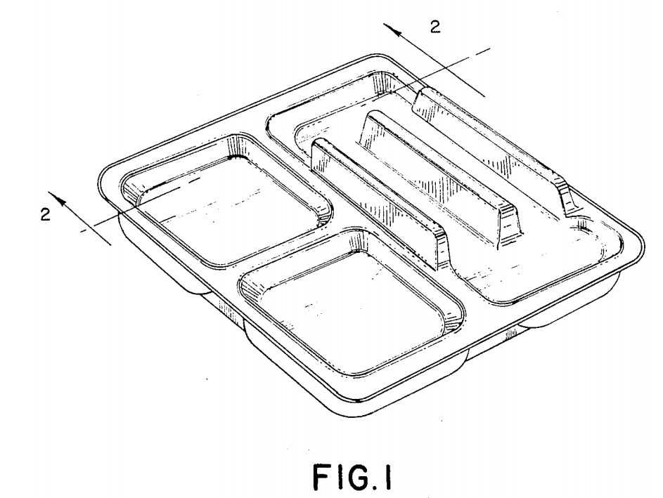
WHAT IS A PATENT?
Public domain image courtesy of the United States Patent and Trademark Office

Slide 40
HOW DO I GET A PATENT?
Inventing doesn’t just involve inventors!
Lawyers have to prepare the patent application.
Artists have to draw the invention.
The government has to approve the patent.

Slide 41
HOW DO I GET A PATENT?
A “patent agent” or “patent attorney” helps prepare “claims” that define the invention and a description (or “specification”) of how to make and use the invention.

Slide 42
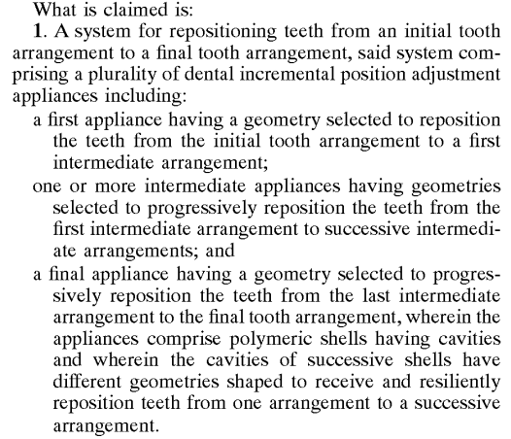
How do I get a patent?
Public domain image courtesy of the United States Patent and Trademark Office

Slide 43
HOW DO I GET A PATENT?
An artist will help draw the invention.

Slide 44
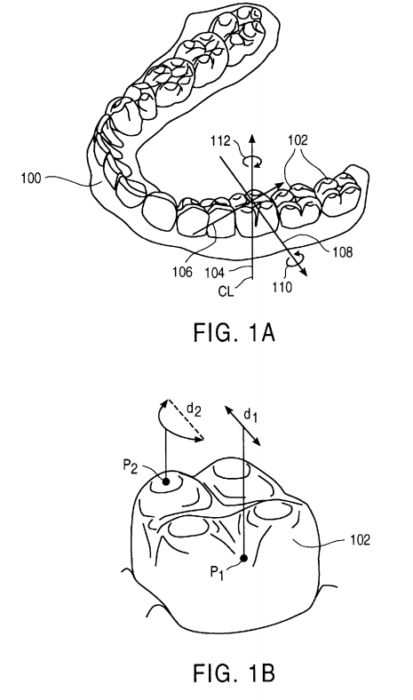
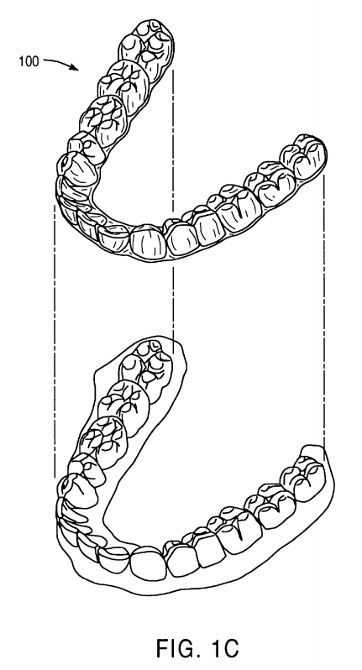
How do I get a patent?
Public domain images courtesy of the United States Patent and Trademark Office

Slide 45
HOW DO I GET A PATENT?
The government has to approve.
The United States has a Patent and Trademark Office in Virginia that employs 1000s of “patent examiners.”

Slide 46
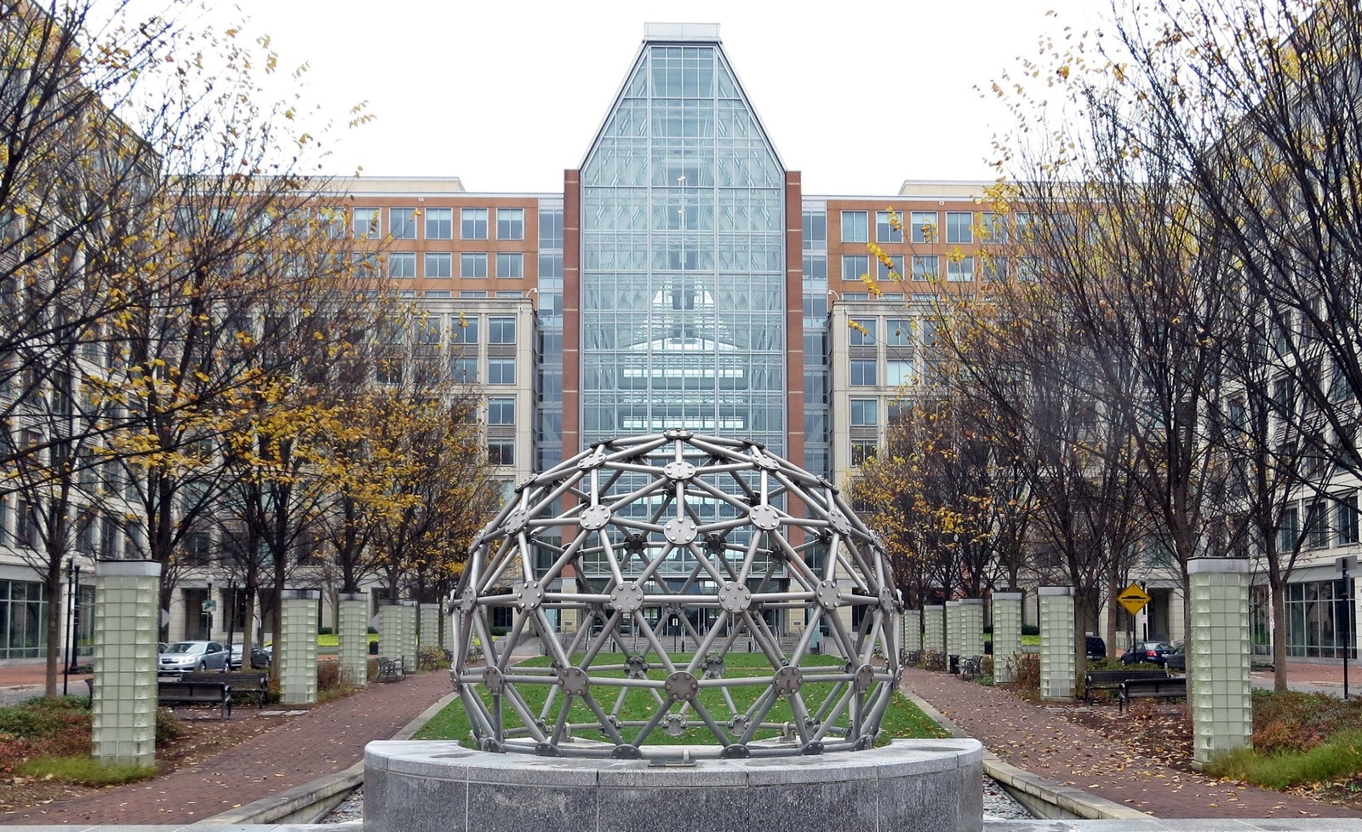
How do I get a patent?
Public domain image courtesy of the United States Small Business Administration

Slide 47
HOW DO I GET A PATENT?
These patent examiners review patent applications to make sure they are written correctly.
If your patent application doesn’t explain how to make and use your invention, the examiner will “reject” it.

Slide 48
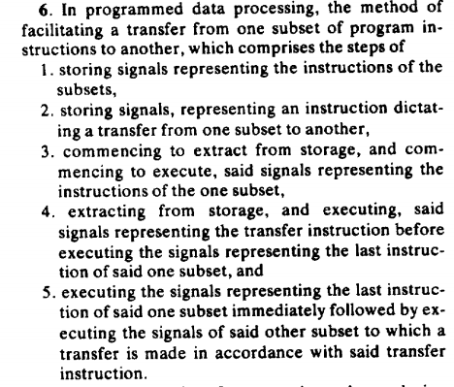
How do I get a patent?
Public domain image courtesy of the United States Patent and Trademark Office

Slide 49
HOW DO I GET A PATENT?
Patent examiners also review patent applications to make sure inventions are new.
If the patent examiner finds that someone else had the same idea earlier, the examiner will “reject” your application.

Slide 50
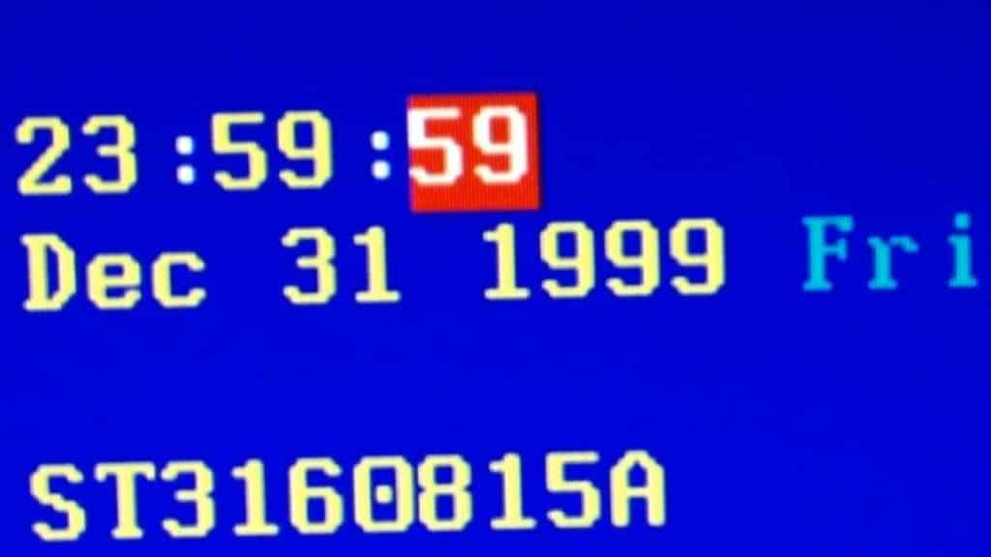
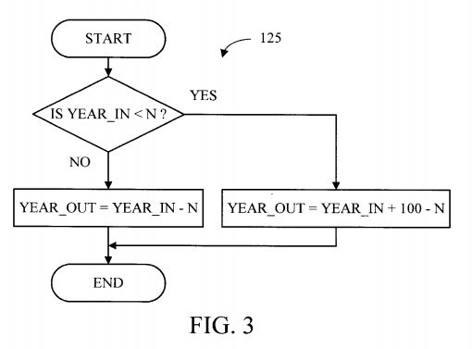
How do I get a patent?
This copyrighted photo has been published by Network Encyclopedia and is used for educational purposes consistent with United States copyright laws
Public domain image courtesy of the United States Patent and Trademark Office

Slide 51
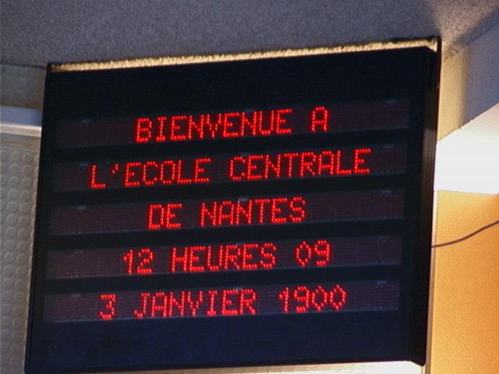
How do I get a patent?
Image from Bug de l'an 2000 used per CC BY-SA 3.0 license
Public domain image courtesy of the United States Patent and Trademark Office

Slide 52
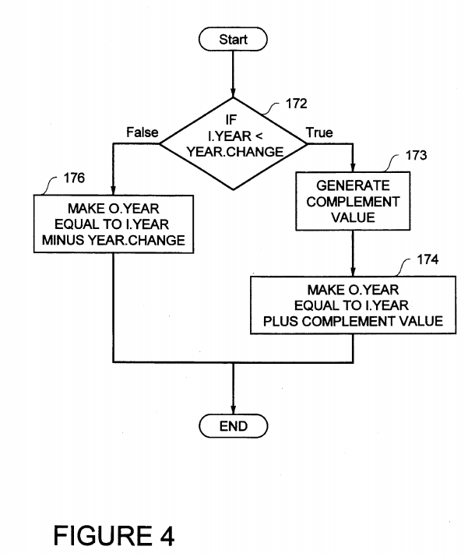
How do I get a patent?
Public domain images courtesy of the United States Patent and Trademark Office

Slide 53

How do I get a patent?
This copyrighted photo has been published by Mast General Store and is used for educational purposes consistent with United States copyright laws

Slide 54
HOW DO I GET A PATENT?
You have another chance!
A patent attorney or agent can explain why the patent examiner is wrong.
Or, the attorney or agent can “narrow” the claims, which makes your invention more specific.

Slide 55
Finally! My PATENT!
Public domain image courtesy of the United States Patent and Trademark Office

