Slide 1
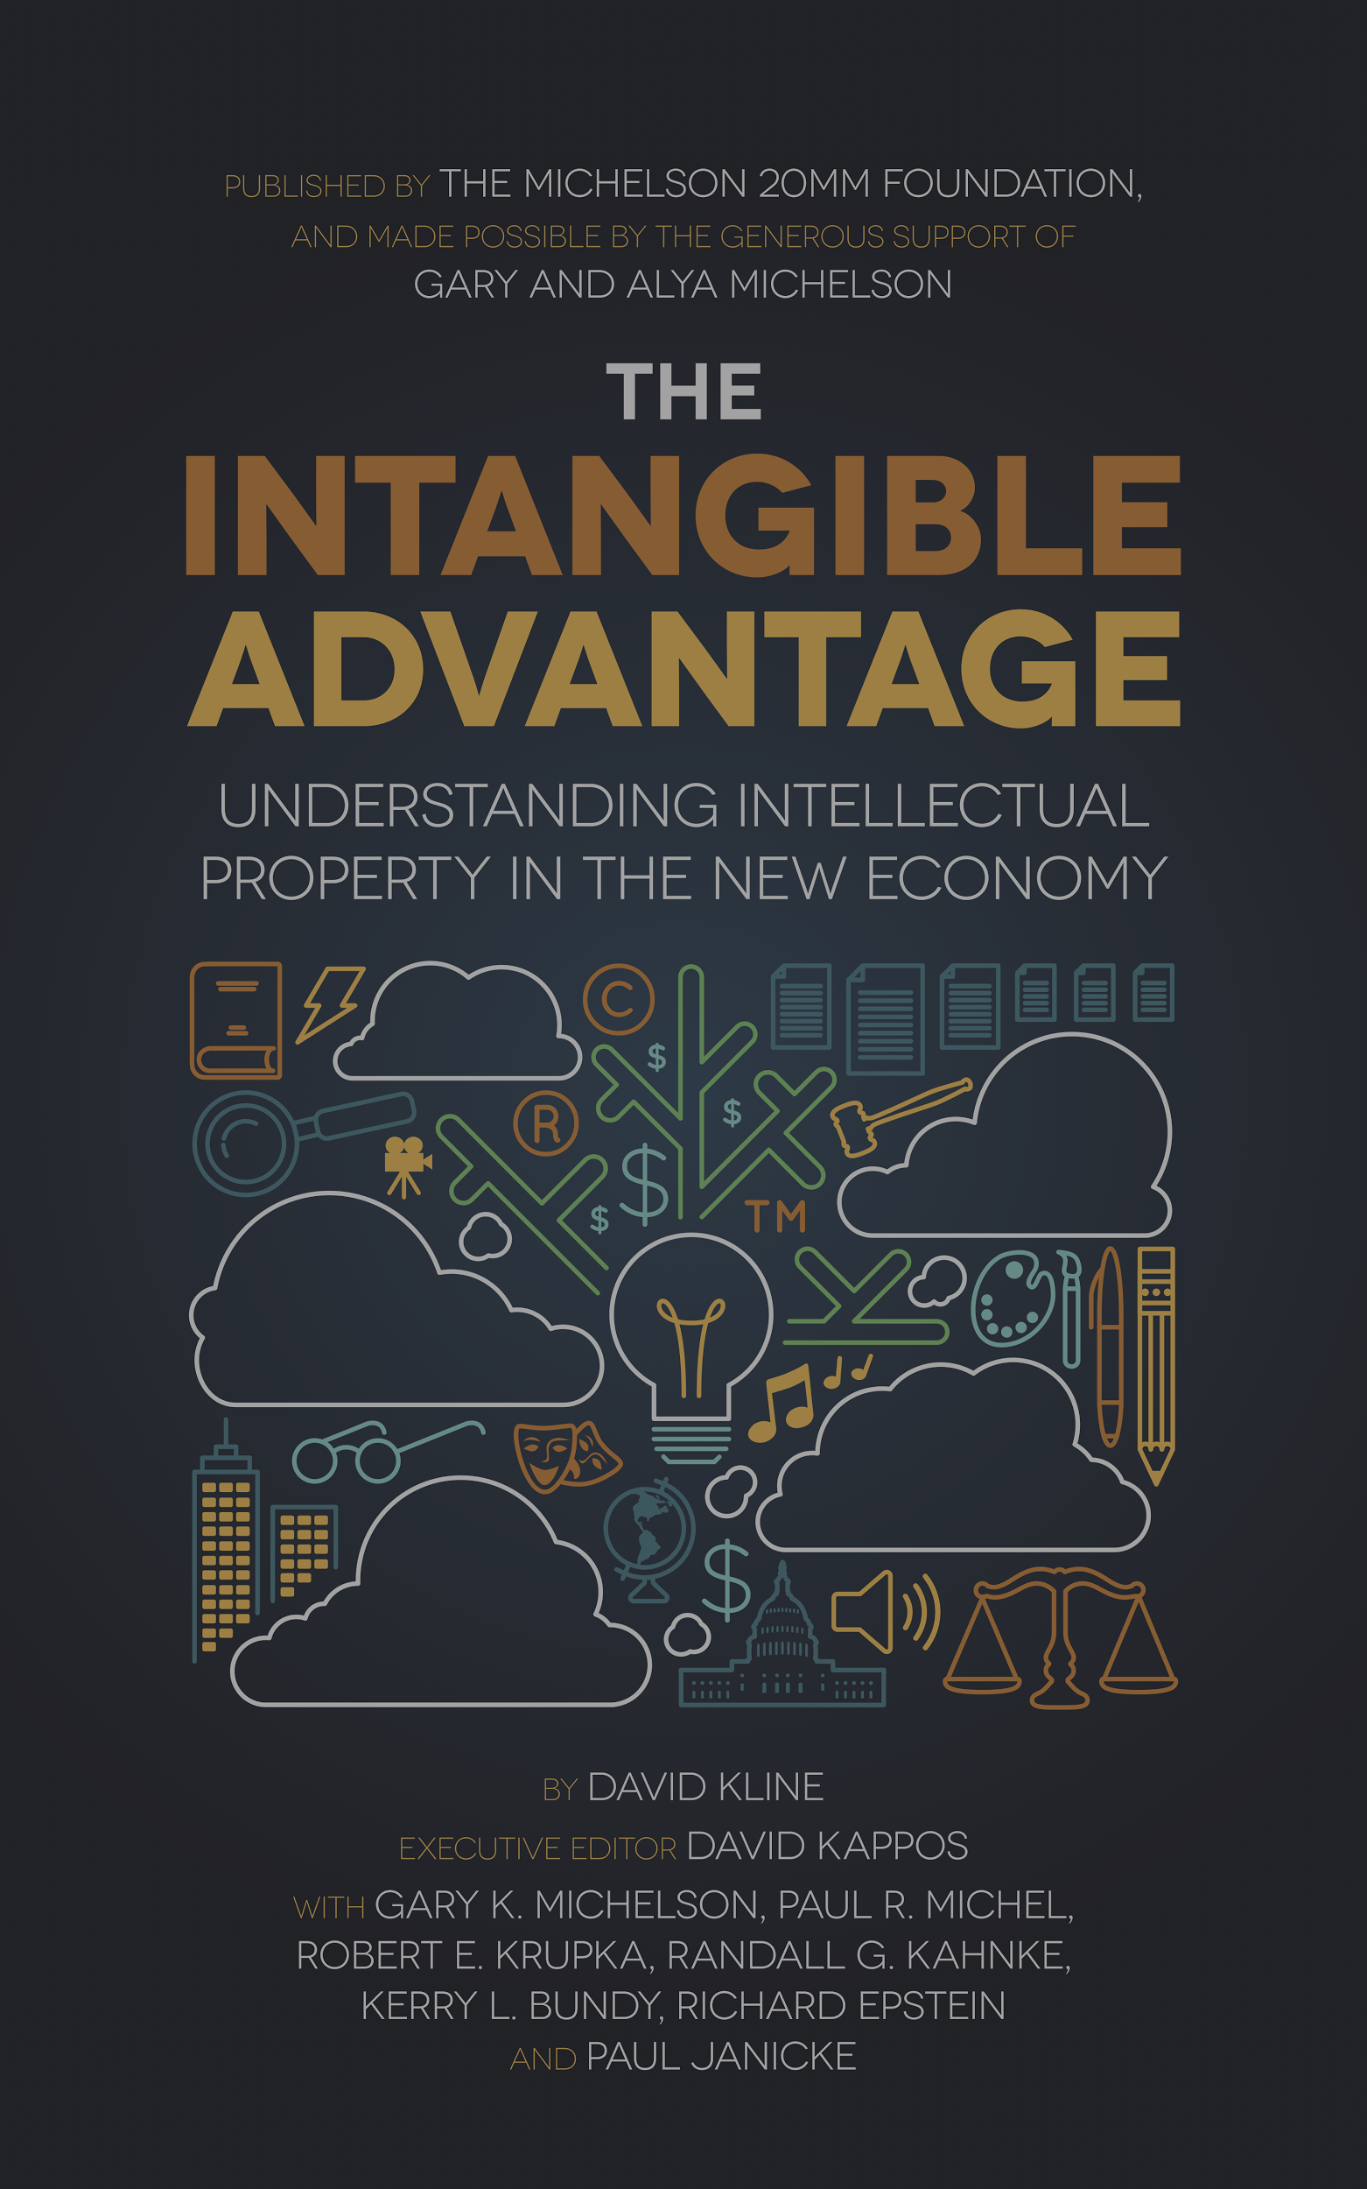
Intellectual Property
In The New Economy:
Supporting Inventors,
Entrepreneurs, & Creators

Slide 2
What is Intellectual Property?
Trade Secrets
Patents
Copyrights
Trademarks
Notes:
The legal foundation for U.S. intellectual property rights was laid by the Founders in 1787, in the very first Article of the U.S. Constitution, which outlined the precepts of our democratic society.
In Article 1, Section 8, Clause 8 of the Constitution, Congress was given the authority to “promote the progress of Science and useful Arts, by securing for limited times to authors and inventors the exclusive right to their respective writings and discoveries”

Slide 3
Patents
An intellectual property right granted by the government of a nation to an inventor that gives him or her the exclusive right to the invention for up to 20 years, in exchange for disclosing the details of the new technology to society for its ultimate benefit.
Notes:
Patents: A patent is an intellectual property right granted by the government of a nation to an inventor that gives him or her the exclusive right to the invention for up to 20 years, in exchange for disclosing the details of the new technology to society for its ultimate benefit.

Slide 4
Copyrights
An intellectual property right granted by a government to the author of an original literary, dramatic, musical, artistic, or other eligible creative work.
Notes:
Copyright: A copyright is an intellectual property right granted by a government to the author of an original literary, dramatic, musical, artistic, or other eligible creative work. It gives the creator the exclusive right for a limited time to control how the work is published, reproduced, performed, or displayed.

Slide 5
Trademarks
An intellectual property right granted by a government to an individual, business, or legal entity that creates and uses a distinctive word, name, symbol, or device to distinguish its products or services from those from any other entity in the marketplace.
Notes:
Trademarks: A trademark is an intellectual property right granted by a government to an individual, business, or legal entity that creates and uses a distinctive word, name, symbol, or device to distinguish its products or services from those from any other entity in the marketplace.

Slide 6
Trade Secrets
A law that requires that the intellectual property to be protected, not publicly disclosed.
Notes:
Trade Secrets: Trade secret law is a source of protection for intellectual property that serves as an alternative to patent or trademark law; requiring that the intellectual property not be publicly disclosed.

Slide 7
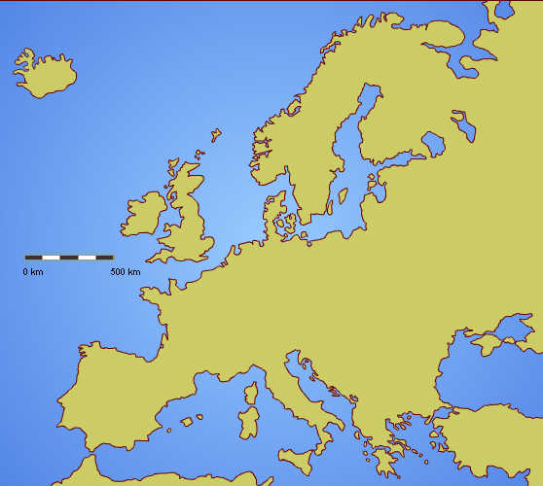
The History of Patents
Greece, 500 BC
Europe, 1700s
Early Patent Systems Reinforced Wealth of Elites
Notes:
The History of Patents - What are the origins of the patent system?
Patent-like incentives first appeared in ancient Greece in 500 BC, and continued to spread throughout Europe through the 1700s. Early patent systems reinforced the wealth of elites instead of the welfare and productive capacity of the whole of society.
British patent application fees, for example, were more than 11 times the per capita income of the average citizen. This restricted innovation to a small sector of the population.

Slide 8
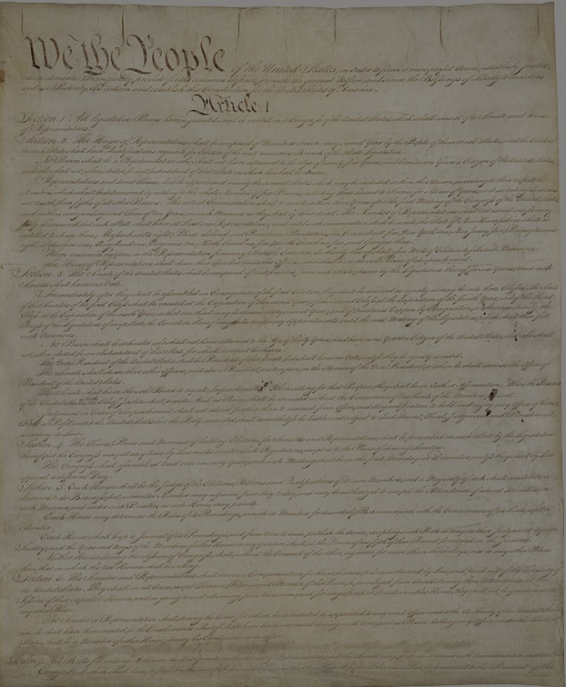
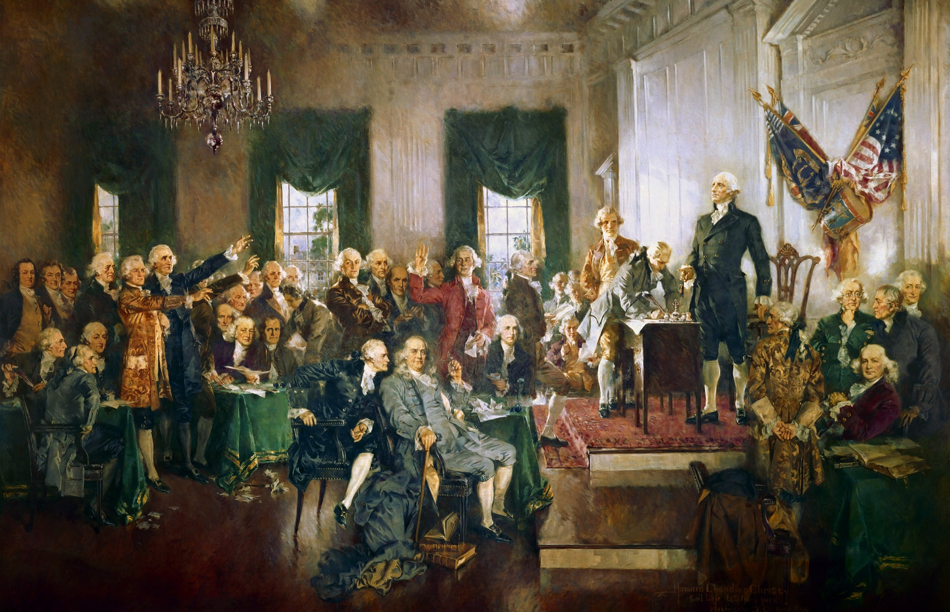
What Is The Rationale For Issuing A Patent?
The Founding Fathers designed a patent system that would “stimulate the inventive genius and entrepreneurial energy of the common man.”
Notes:
Foundations of Patent Protection - What is the rationale for issuing a patent?
As the first country in the world to incorporate intellectual property rights in its national constitution, America’s founders viewed intellectual property rights as vital to the nation’s economic survival.
They consciously designed a patent system that would do what no patent system had ever done before — stimulate the inventive genius and entrepreneurial energy of the common man.

Slide 9
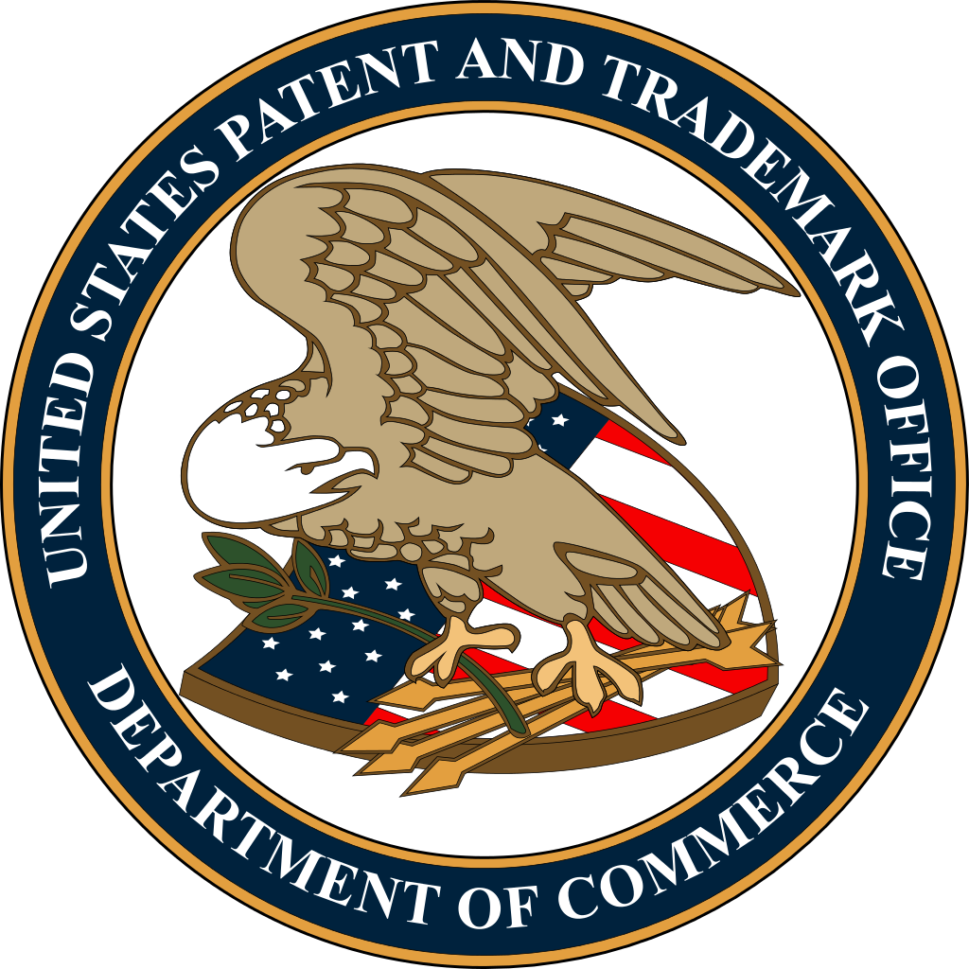
Two Goals of Today’s U.S. Patent System
Stimulate Invention
Property rights are protected to help ensure creation and productivity
Share Knowledge
Promote progress and “the general welfare” by disclosing inventions
Notes:
Today’s U.S.patent system satisfies two broad goals:
Stimulates invention: The inherent property rights of inventors and authors to their creations are protected, thereby helping to ensure that the wellsprings of creation and productivity do not dry up for lack of incentive.
Is an effective tool for knowledge sharing: The benefits derived from these inventions and creations are ultimately harnessed to the public good through disclosure, thus promoting the progress of the nation and “the general welfare” of its citizens.

Slide 10
How Has The Patent System Supported U.S. Economic Growth?
Notes:
The Patent System and U.S. Economic Growth - How has the patent system supported U.S. Economic Growth?
The U.S. patent system stimulated invention and economic growth and quickly became the unrivaled leader of the Industrial Revolution.
By 1870, the U.S. was patenting more than 5x the number of inventions as Britain, even though their populations were nearly equal in size.

Slide 11
Fostering Innovation
300K
2014
100K
1980s
40K
1900s
20K
1880s
Patenting Spikes
Notes:
The patent system’s central role in fostering innovation can be seen in the patenting spikes that occurred with every major industrial breakthrough.
1880s - major surge in patenting, with the annual number of new patents issued jumping from 12,000 in the 1870s to ~20,000 in the 1880s. This patent boom corresponded with rapid advances in the emerging railroad, telegraph, telephone, and electric light and power industries.
1900s - similarly, during the birth and early-stage growth of the automobile and aircraft industries. Patents granted at this time doubled from 20,000 per year to 40,000 per year.
1980s - when the personal computer and emerging high-tech industries propelled us toward the age of the Internet. Patenting levels then increased from approximately 80,000 to 100,000 each year.
Today, with the rise of the internet, social media, and smartphones over the last two decades, the number of patent applications filed each year with the USPTO has surged fourfold. In 2014, the USPTO received 578,802 applications, 300,678 of which received a patent.

Slide 12
What, Exactly, Can You Patent?
“The Patent Act”
A machine, manufacture, process, or composition of matter can be patented if it demonstrates the following three characteristics:
Novelty
Non-Obviousness
Utility
Notes:
Criteria for Patenting - What, Exactly, Can You Patent?
“The Patent Act,” says that a machine, manufacture, process, or composition of matter can be patented if it demonstrates the following three characteristics:
Novelty
Non-obviousness, and
Utility

Slide 13
Criteria for Patenting
Novelty
A machine, manufacture, process, or composition of matter must not have been previously described or known.
Utility
An invention must function as intended.
Non-Obviousness
A patent requirement that ensures that the idea is new.

Slide 14
Two Categories for Patentable Inventions
Notes:
Patentable inventions fall into one of two categories: products or processes.
You cannot patent ideas; the most important reason why one thing is patentable and another is not lies in the difference between ideas and applications.
You cannot patent mathematical formulas, a law of nature or a natural phenomena; they all exist independently of human intervention, making this knowledge freely available.

Slide 15
Products
Notes:
NOTE: Example Slide

Slide 16
Processes
Notes:
NOTE: Example Slide

Slide 17
Non-Obviousness Hurdle
Camera + Phone
=
Non-Obviousness
Notes:
Camera phone example:
Inventing the camera phone was not so obvious in meeting the non-obviousness patent requirement.
While composed of well-known and widely-available components, combining the two did satisfy the non-obviousness requirement because it became more than the sum of its parts, and met a large and previously-unfilled need in the marketplace.
This is apparent as we see millions of people who take selfies everyday.

Slide 18
How Are Patent Rights Protected?
It is up to the “Patentee” to enforce their patent against infringers by filing a case in federal court
Patent holders have the legal right to exclude others from making, using, selling, or importing the invention
Notes:
Enforcing Patent Rights - How are patent rights protected?
Patent Law and Enforcement
Patents can be enforced by their owners in U.S. federal courts. It is up to the owner of the patent, the “patentee,” to enforce it against infringers by filing a civil case in federal court for patent infringement.
Patent infringement occurs regardless of the infringer’s lack of knowledge of the patent or their intent to infringe it.
In modern times, patent enforcement has become a long and very expensive process. Patent litigation serves a vital function in society by settling the validity and disputed ownership of patent rights so these can be commercialized into new products, services, and medical treatments.

Slide 19
Patent Infringement
Demand the infringer stop & pay damages for past infringement
Offer a “Royalty”
Ignore the infringement or postpone action
File a patent infringement lawsuit in federal court
Notes:
Patent Infringement
If the patentee believes their patent is being infringed, they should first hire a patent trial lawyer; the lawyer will evaluate the patent and the accused device or process to provide a legal opinion about whether or not an infringement exists.
If infringement is found, options for pursuing a patent infringement claim include:
Demand that the alleged infringer stop infringing and pay damages for past infringement.
Offer the alleged infringer a license to practice your invention for money, called “royalty.”
Ignore the infringement, or postpone any action for a time.
File a patent infringement lawsuit in federal court against the alleged infringer.

Slide 20
The Value of IP to a Nation’s Economic Survival
38%
U.S. GDP
80%
Market Value
Notes:
Intellectual Property (IP) rights are vital to a nation's economic survival; IP comprises an astonishing 38 percent of total U.S. GDP today, and represents 80 percent of the market value of all publicly traded companies in the U.S. As a result, any young person today who does not understand the basics of intellectual property--and its value and role in science, business, and arts professions--will find him or herself at a distinct disadvantage in the world of tomorrow.

Slide 21
To learn more about IP visit:
MichelsonIP.com
Presented By
Notes:
Over the last 40 years, intellectual property has grown from an arcane, narrowly-specialized legal field into a major force in American social and economic life.
Intellectual property is now the chief engine of wealth creation and economic growth in the world.
America’s patent system helped create the most successful economy on the face of the earth. The Founders designed the world’s first democratized intellectual property system, precisely because they believed in the ingenuity of the common citizen.

