Slide 1
Intellectual Property
In The New Economy:
Supporting Inventors,
Entrepreneurs, & Creators

Slide 2
What is Intellectual Property?
Trade Secrets
Patents
Copyrights
Trademarks
Notes:
The legal foundation for U.S. intellectual property rights was laid by the Founders in 1787, in the very first Article of the U.S. Constitution, which outlined the precepts of our democratic society. In Article 1, Section 8, Clause 8 of the Constitution, Congress was given the authority to “promote the progress of Science and useful Arts, by securing for limited times to authors and inventors the exclusive right to their respective writings and discoveries”

Slide 3
Patents
An intellectual property right granted by the government of a nation to an inventor that gives him or her the exclusive right to the invention for up to 20 years, in exchange for disclosing the details of the new technology to society for its ultimate benefit.
Notes:
Patents: A patent is an intellectual property right granted by the government of a nation to an inventor that gives him or her the exclusive right to the invention for up to 20 years, in exchange for disclosing the details of the new technology to society for its ultimate benefit.

Slide 4
Copyrights
An intellectual property right granted by a government to the author of an original literary, dramatic, musical, artistic, or other eligible creative work.
Notes:
Copyright: A copyright is an intellectual property right granted by a government to the author of an original literary, dramatic, musical, artistic, or other eligible creative work. It gives the creator the exclusive right for a limited time to control how the work is published, reproduced, performed, or displayed.

Slide 5
Trademarks
An intellectual property right granted by a government to an individual, business, or legal entity that creates and uses a distinctive word, name, symbol, or device to distinguish its products or services from those from any other entity in the marketplace.
Notes:
Trademarks: A trademark is an intellectual property right granted by a government to an individual, business, or legal entity that creates and uses a distinctive word, name, symbol, or device to distinguish its products or services from those from any other entity in the marketplace.

Slide 6
Trade Secrets
A law that requires that the intellectual property to be protected, not publicly disclosed.
Notes:
Trade Secrets: Trade secret law is a source of protection for intellectual property that serves as an alternative to patent or trademark law; requiring that the intellectual property not be publicly disclosed.

Slide 7
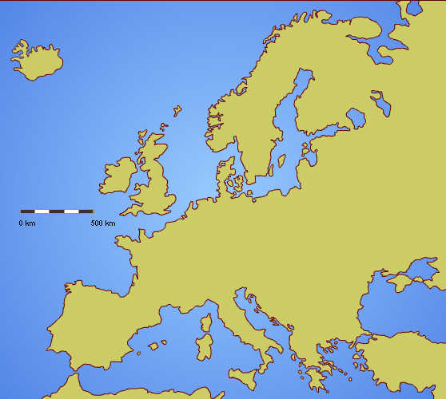
The History of Patents
Greece, 500 BC
Europe, 1700s
Early Patent Systems Reinforced Wealth of Elites
Notes:
The History of Patents - What are the origins of the patent system?
Patent-like incentives first appeared in ancient Greece in 500 BC, and continued to spread throughout Europe through the 1700s. Early patent systems reinforced the wealth of elites instead of the welfare and productive capacity of the whole of society.
British patent application fees, for example, were more than 11 times the per capita income of the average citizen. This restricted innovation to a small sector of the population.

Slide 8
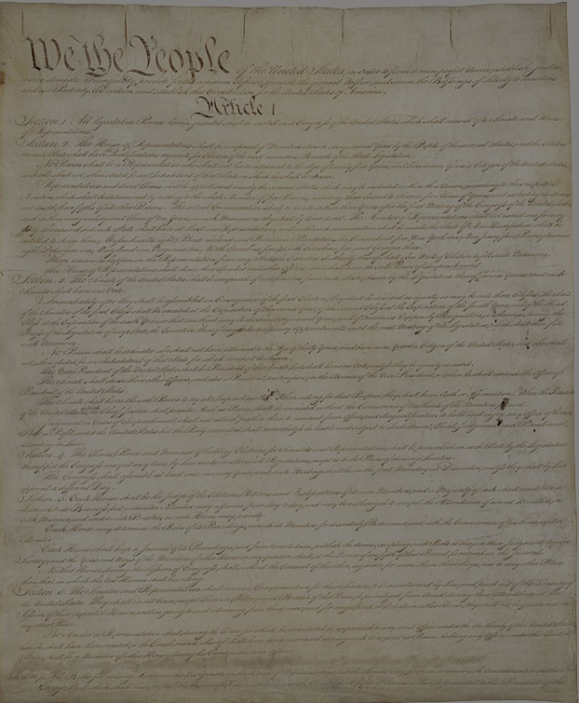
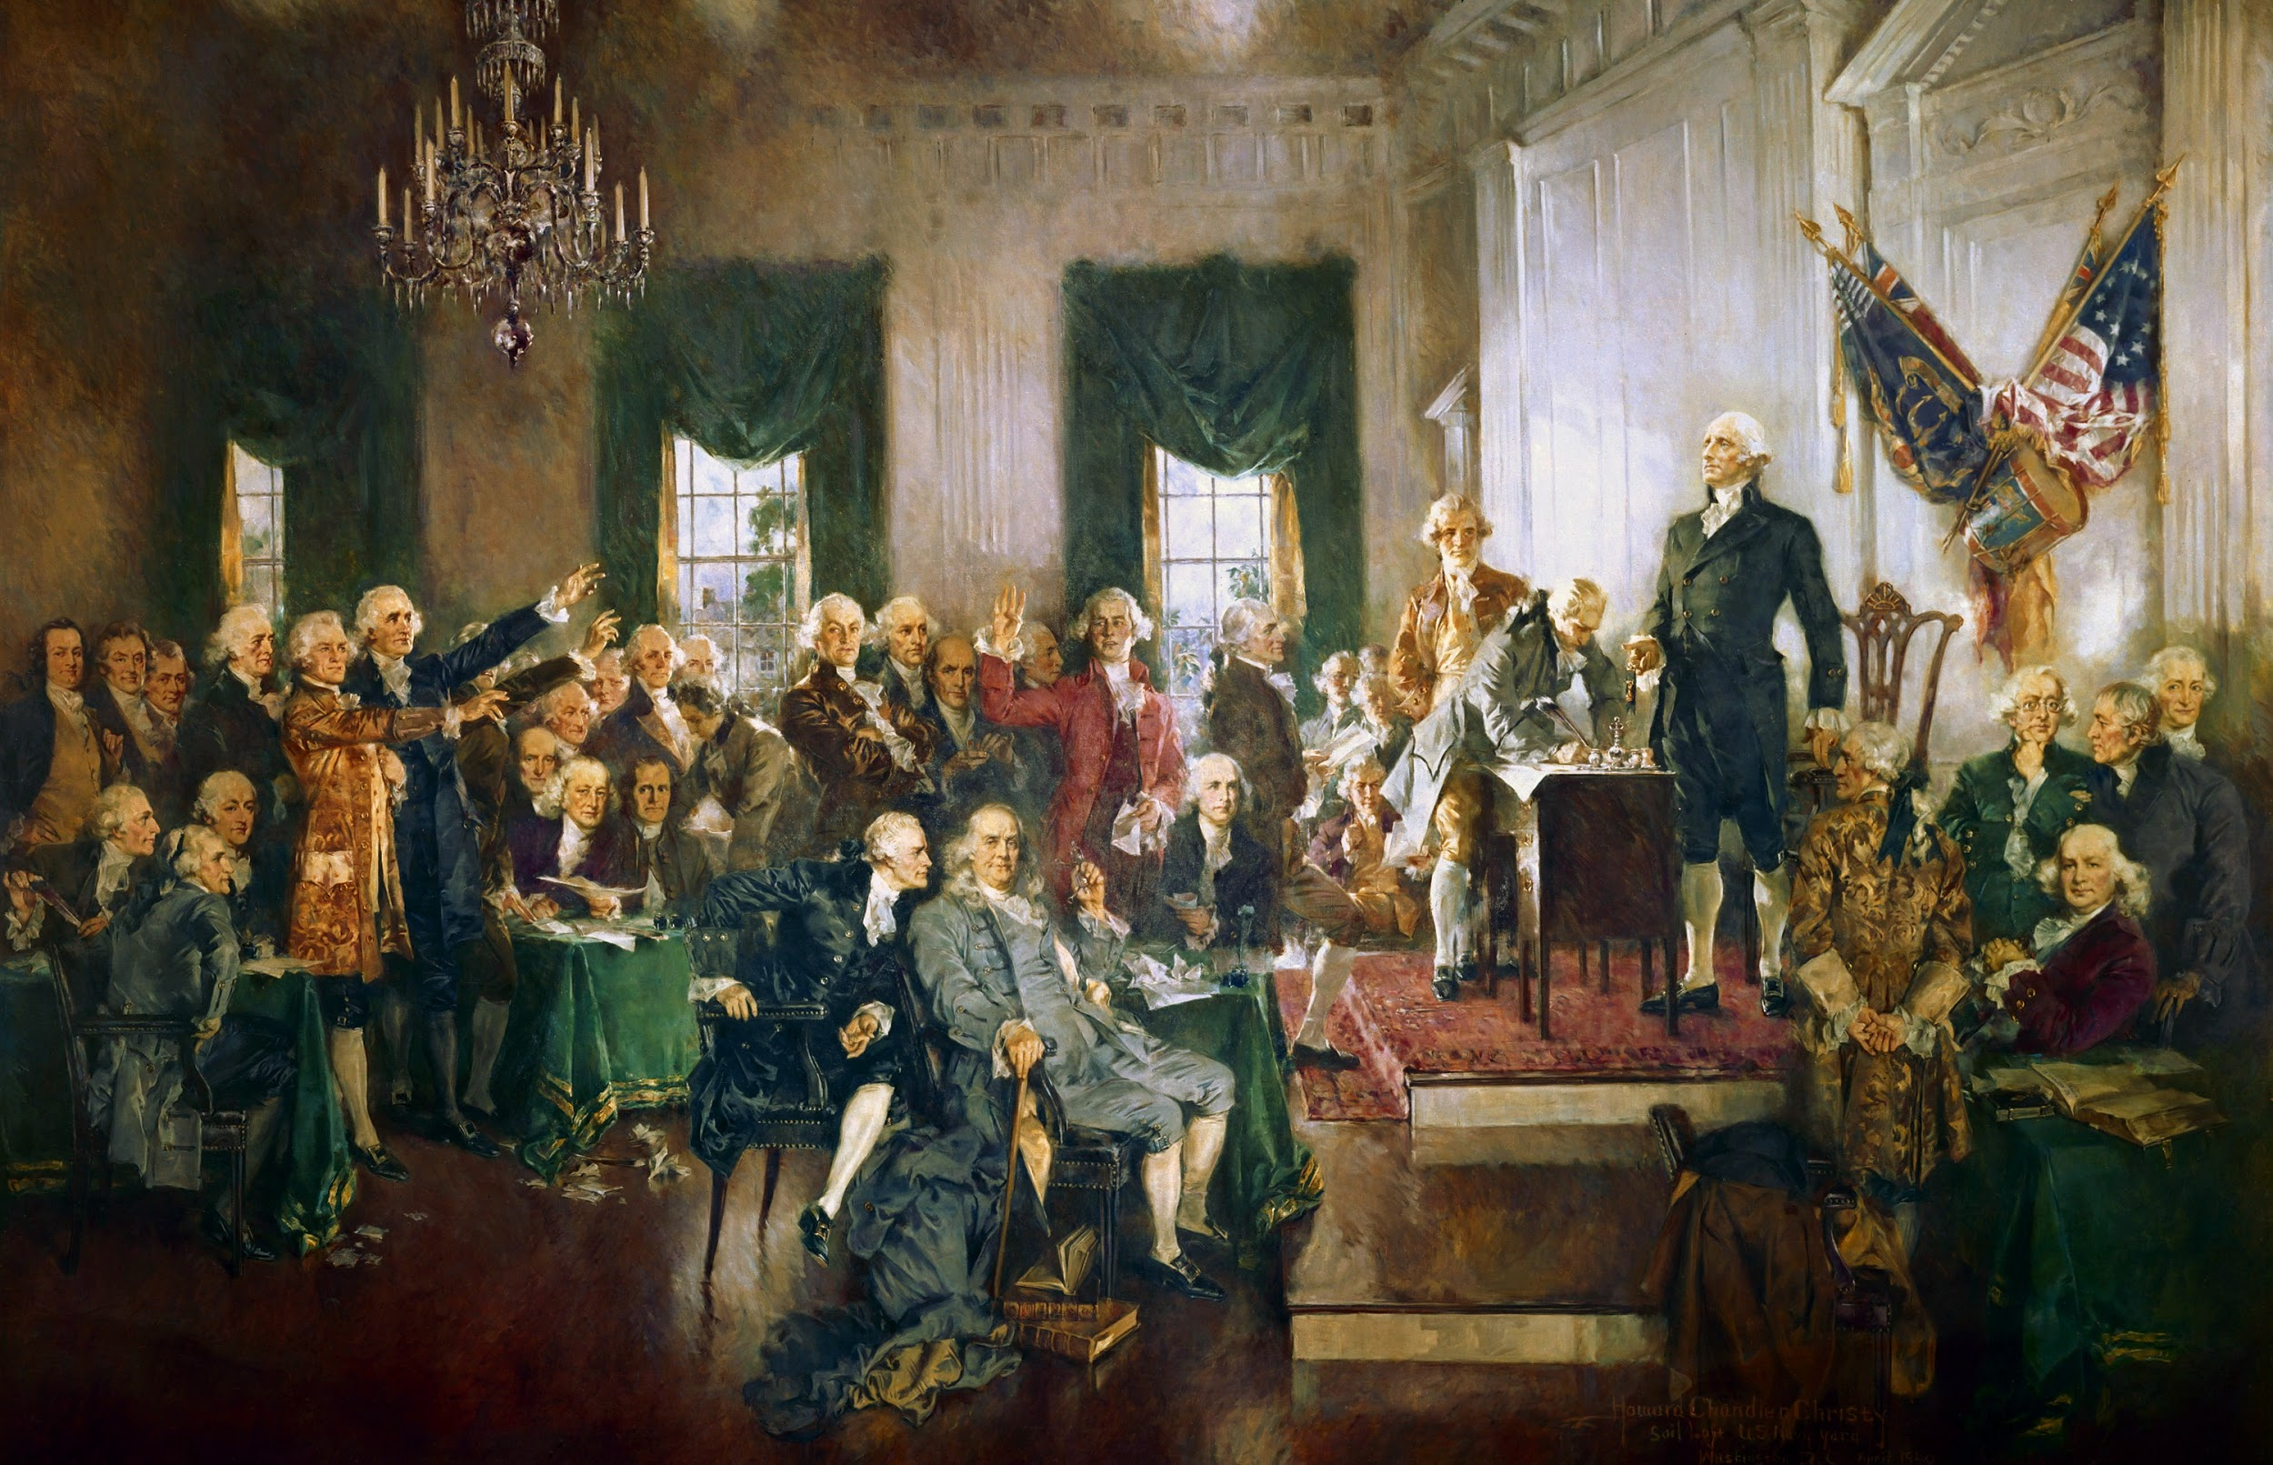
What Is The Rationale For Issuing A Patent?
The Founding Fathers designed a patent system that would “stimulate the inventive genius and entrepreneurial energy of the common man.”
Notes:
Foundations of Patent Protection - What is the rationale for issuing a patent?
As the first country in the world to incorporate intellectual property rights in its national constitution, America’s founders viewed intellectual property rights as vital to the nation’s economic survival.
They consciously designed a patent system that would do what no patent system had ever done before — stimulate the inventive genius and entrepreneurial energy of the common man.

Slide 9
Natural Rights Theory
Bargain Theory
Notes:
The founder’s philosophy of the value of intellectual property rights can be explained with two justifications:
Bargain Theory: In exchange for inventing something useful, society gives the inventor the exclusive right to his invention for a limited time, after which it goes into to the public domain and belongs to society.
Natural Rights Theory: Discusses the inventors’ inherent rights of property. In exchange for disclosing to the public the nature and details of the invention, the Constitution authorizes the government to enforce the inventor’s exclusive property right to that invention for a limited time.

Slide 10
Two Goals of Today’s U.S. Patent System
Stimulate Invention
Property rights are protected to help ensure creation and productivity
Share Knowledge
Promote progress and “the general welfare” by disclosing inventions
Notes:
From these theories rose today’s U.S.patent system, satisfying two broad goals:
Stimulates invention: The inherent property rights of inventors and authors to their creations are protected, thereby helping to ensure that the wellsprings of creation and productivity do not dry up for lack of incentive.
Is an effective tool for knowledge sharing: The benefits derived from these inventions and creations are ultimately harnessed to the public good through disclosure, thus promoting the progress of the nation and “the general welfare” of its citizens.

Slide 11
How Did The U.S. Create A Patent System For Everyone?
Six Unique Features
Simple Application Procedure
Disclosure of New Technology
Low Fees
Examination System
No “Working Requirements”
New Technology Marketplace
Notes:
America’s Uniquely Democratic Patent System - How did the U.S. create a patent system for everyone?
In order to create a patent system that benefits everyone and facilities innovation, the founding fathers integrated six unique democratic features into the U.S. patent system:
Low fees: making patents affordable to ensure that all citizens, including the poor, could participate in the developing industrial revolution.
Simplified application procedures
Disclosure of new technology developments
World’s first examination system of patents for validity
No “Working Requirements” reduced monopoly control
A new technology marketplace
As a result, these unique features of the U.S. patent system greatly expanded the number of inventors in our nation, and led to a dramatic surge in innovation not seen anywhere in the world before.

Slide 12
How Has The Patent System Supported U.S. Economic Growth?
Notes:
The Patent System and U.S. Economic Growth - How has the patent system supported U.S. Economic Growth?
The U.S. patent system stimulated invention and economic growth and quickly became the unrivaled leader of the Industrial Revolution.
By 1870, the U.S. was patenting more than 5x the number of inventions as Britain, even though their populations were nearly equal in size.
The patent system’s central role in fostering innovation can be seen in the patenting spikes that occurred with every major industrial breakthrough.

Slide 13
Fostering Innovation
300K
2014
100K
1980s
40K
1900s
20K
1880s
Patenting Spikes
Notes:
1880s - major surge in patenting, with the annual number of new patents issued jumping from 12,000 in the 1870s to ~20,000 in the 1880s. This patent boom corresponded with rapid advances in the emerging railroad, telegraph, telephone, and electric light and power industries.
1900s - similarly, during the birth and early-stage growth of the automobile and aircraft industries. Patents granted at this time doubled from 20,000 per year to 40,000 per year.
1980s - when the personal computer and emerging high-tech industries propelled us toward the age of the Internet. Patenting levels then increased from approximately 80,000 to 100,000 each year.
Today, with the rise of the internet, social media, and smartphones over the last two decades, the number of patent applications filed each year with the USPTO has surged fourfold. In 2014, the USPTO received 578,802 applications, 300,678 of which received a patent.

Slide 14
What, Exactly, Can You Patent?
“The Patent Act”
A machine, manufacture, process, or composition of matter can be patented if it demonstrates the following three characteristics:
Novelty
Non-Obviousness
Utility
Notes:
Criteria for Patenting - What, Exactly, Can You Patent?
Title 35 of the United States Code, also known as “The Patent Act,” says that a machine, manufacture, process, or composition of matter can be patented if it demonstrates the following three characteristics:
Novelty
Non-obviousness, and
Utility

Slide 15
Criteria for Patenting
Novelty
A machine, manufacture, process, or composition of matter must not have been previously described or known.
Utility
An invention must function as intended.
Non-Obviousness
A patent requirement that ensures that the idea is new.

Slide 16
Two Categories for Patentable Inventions
Notes:
Patentable inventions fall into one of two categories: products or processes.
You cannot patent ideas; the most important reason why one thing is patentable and another is not lies in the difference between ideas and applications.
You cannot patent mathematical formulas, a law of nature or a natural phenomena; they all exist independently of human intervention, making this knowledge freely available.

Slide 17
Products
Notes:
NOTE: Example Slide

Slide 18
Processes
Notes:
NOTE: Example Slide

Slide 19
Non-Obviousness Hurdle
Camera + Phone
=
Non-Obviousness
Notes:
Camera phone example:
Inventing the camera phone was not so obvious in meeting the non-obviousness patent requirement.
While composed of well-known and widely-available components, combining the two did satisfy the non-obviousness requirement because it became more than the sum of its parts, and met a large and previously-unfilled need in the marketplace.
This is apparent as we see millions of people who take selfies everyday.

Slide 20
Plant & Design Patents
Distinctiveness
Ornamentality
Notes:
The Patent Act provides two other types of patents, plant and design patents; requirements for plant and design patents are substantially the same as those for utility patents but instead of novelty, utility, and non-obviousness:
The criteria for plant patents are novelty, distinctiveness, and non-obviousness.
The criteria for design patents are novelty, ornamentality, and non-obviousness.

Slide 21
Enforcing Patent Rights
It is up to the “Patentee” to enforce their patent against infringers by filing a case in federal court
Patent holders have the legal right to exclude others from making, using, selling, or importing the invention
Notes:
Enforcing Patent Rights - How are patent rights protected?
Patent Law and Enforcement
Patents can be enforced by their owners in U.S. federal courts. It is up to the owner of the patent, the “patentee,” to enforce it against infringers by filing a civil case in federal court for patent infringement.
It’s important to note that patent rights only exclude others from using the patentee’s invention; patent holders have the legal right to exclude others from making, using, selling, or importing the patented invention throughout the U.S.
Patent infringement occurs regardless of the infringer’s lack of knowledge of the patent or their intent to infringe it.
In modern times, patent enforcement has become a long and very expensive process. Patent litigation serves a vital function in society by settling the validity and disputed ownership of patent rights so these can be commercialized into new products, services, and medical treatments.

Slide 22
Patent Infringement
Demand the infringer stop & pay damages for past infringement
Offer a “Royalty”
Ignore the infringement or postpone action
File a patent infringement lawsuit in federal court
Notes:
Patent Infringement
If the patentee believes their patent is being infringed, they should first hire a patent trial lawyer; the lawyer will evaluate the patent and the accused device or process to provide a legal opinion about whether or not an infringement exists.
If infringement is found, options for pursuing a patent infringement claim include:
Demand that the alleged infringer stop infringing and pay damages for past infringement.
Offer the alleged infringer a license to practice your invention for money, called “royalty.”
Ignore the infringement, or postpone any action for a time.
File a patent infringement lawsuit in federal court against the alleged infringer.

Slide 23
Litigation
vs
Licensing
If the objective is to stop a competitor from offering a product that infringes one’s patent.
If the objective is to obtain royalty for the use of one’s invention.
Notes:
Litigation vs. Licensing
The best option for pursuing a patent infringement claim depends on the patentee’s objectives.
Litigation - If the objective is to stop a competitor from offering a competing product that infringes one’s patent, the patentee has to file a lawsuit and pursue it to completion. However, litigation is costly, anywhere from $1million to over $10 million.
Licensing - If the objective is to obtain royalty for the use of one’s invention, the patentee may be able to negotiate a license agreement without the need for litigation.

Slide 24
Should You Take Your Claim To Court?
To enforce a patent through litigation, you must determine the who, what, where, when, and how of events...
Determine who infringed
Create a claim chart detailing the product & service that has infringed
Determine your location of suit
File your claim as soon as you have proof
Select a judge or jury
Notes:
Should You Take the Claim to Court?
While time consuming, successful patentees can reap huge monetary damages for another’s patent infringement and possibly increased market share.
Once the decision to enforce a patent through litigation, a series of complex steps begins to determine the who, what, where, when, and how of events.
Who - determine the corporation or individual(s) who infringed and whether they should be sued individually or collectively.
What - create a claim chart detailing your patent claims and the product or service that has infringed upon them.
Where - Determine your location or “venue” options and select the one that aligns most closely with your objectives.
When - Once infringement has been discovered, the claim should be filed as soon as you have sufficient evidence to prove the claim.
How - Plaintiffs may select whether their claim is decided by a judge or jury. The complexity of the case often informs this decision.

Slide 25
Alternatives To Litigation
Litigations are costly, timely, & disruptive
Alternative dispute resolutions (ADR) include Mediation & Arbitration
Notes:
Mediation and Arbitration - What are the alternatives to litigation?
The high cost, delay, and disruption of litigation motivate many adversaries to seek alternatives to litigation to resolve their disputes. Two popular alternative dispute resolutions are mediation and arbitration.

Slide 26
Mediation
An informal type of dispute resolution in which a third party (mediator) helps two parties come to an agreement.
Notes:
Mediation is simply an exchange between adversaries overseen by an individual with expertise and/or training in helping parties reach an agreement.

Slide 27
Arbitration
A process in which the parties to a dispute present arguments and evidence to a dispute resolution practitioner (arbitrator) who makes a determination.
Notes:
The main difference between mediation and arbitration is decisiveness. Mediations result in settlements only if all parties agree to a resolution. In most arbitrations, the parties agree to be bound by the decision of the arbitrator(s).
Alternative dispute resolutions are often faster, less expensive, and more private, as compared with public lawsuit procedures.
The driving force behind ADR is confidentiality. The interactions among the parties and the mediators/arbitrators can be kept confidential, as can any settlements reached.

Slide 28
The Value of IP to a Nation’s Economic Survival
38%
U.S. GDP
80%
Market Value
Notes:
Intellectual Property (IP) rights are vital to a nation's economic survival; IP comprises an astonishing 38 percent of total U.S. GDP today, and represents 80 percent of the market value of all publicly traded companies in the U.S. As a result, any young person today who does not understand the basics of intellectual property--and its value and role in science, business, and arts professions--will find him or herself at a distinct disadvantage in the world of tomorrow.

Slide 29
To learn more about IP visit:
MichelsonIP.com
Presented By
Notes:
Over the last 40 years, intellectual property has grown from an arcane, narrowly-specialized legal field into a major force in American social and economic life.
Intellectual property is now the chief engine of wealth creation and economic growth in the world.
America’s patent system helped create the most successful economy on the face of the earth. The Founders designed the world’s first democratized intellectual property system, precisely because they believed in the ingenuity of the common citizen.

